Slide 1
Creative State Approaches to Long-Term Care Financing
New York Long Term Care Planning Council Meeting
October 25, 2019
Gretchen E. Alkema, Ph.D.
Vice President, Policy and Communications

Slide 2
Gretchen’s 3 Takeaways
Demographics + daily functioning shape the new innovation landscape for aging Americans
The time for addressing daily living needs for an aging population = NOW
States have many tools to address daily living needs
Notes:
Bruce opens the discussion.
Today Medicare Advantage plans serve a complex care population, which now mirrors FFS, and opens up an array of opportunities for those who care for them.
The SCAN Foundation and others are documenting how health plans are already emerging as innovators in high value care delivery for this population.
Increasing needs and plan interest to respond, combined with new MA flexibility, will only enhance demand for information and innovation.
We are committed to informing all stakeholders on this issue and wish to collaborate to prioritize research, supplement your work, and contribute to the development of MA plan enhancements in this area that respond to growing populations/needs.

Slide 3
Time To Take Action: NOW
75+ Growing Fastest Among U.S. Population Ages 65 and Older, Starting 2020
72.8 M
65 M
60 M
20.4%
47.7 M
22.4%
14.9%
5.5%
11.6%
19.3%
Source: U.S. Census Bureau, 2012 Population Estimates and 2012 National Projections
Notes:
Bruce presents.
This is the demographics is destiny slide; clearly the future is now.
As this slides shows, the nation will experience extraordinary growth in the 75+ population starting in 2020. And as we also know, unlike the young-old, the old-old will require and demand care. And failure to manage them well will result in healthcare cost burdens to you and them.
Your enrollment will likely increase even faster than the aging of the population b/c MA growth as a percentage of entire Medicare population is increasing so much.
As such, the increase in demographics and percentage of Medicare in MA represents two-fold challenge and opportunity.

Slide 4
What is the problem we are trying to solve?

Slide 5
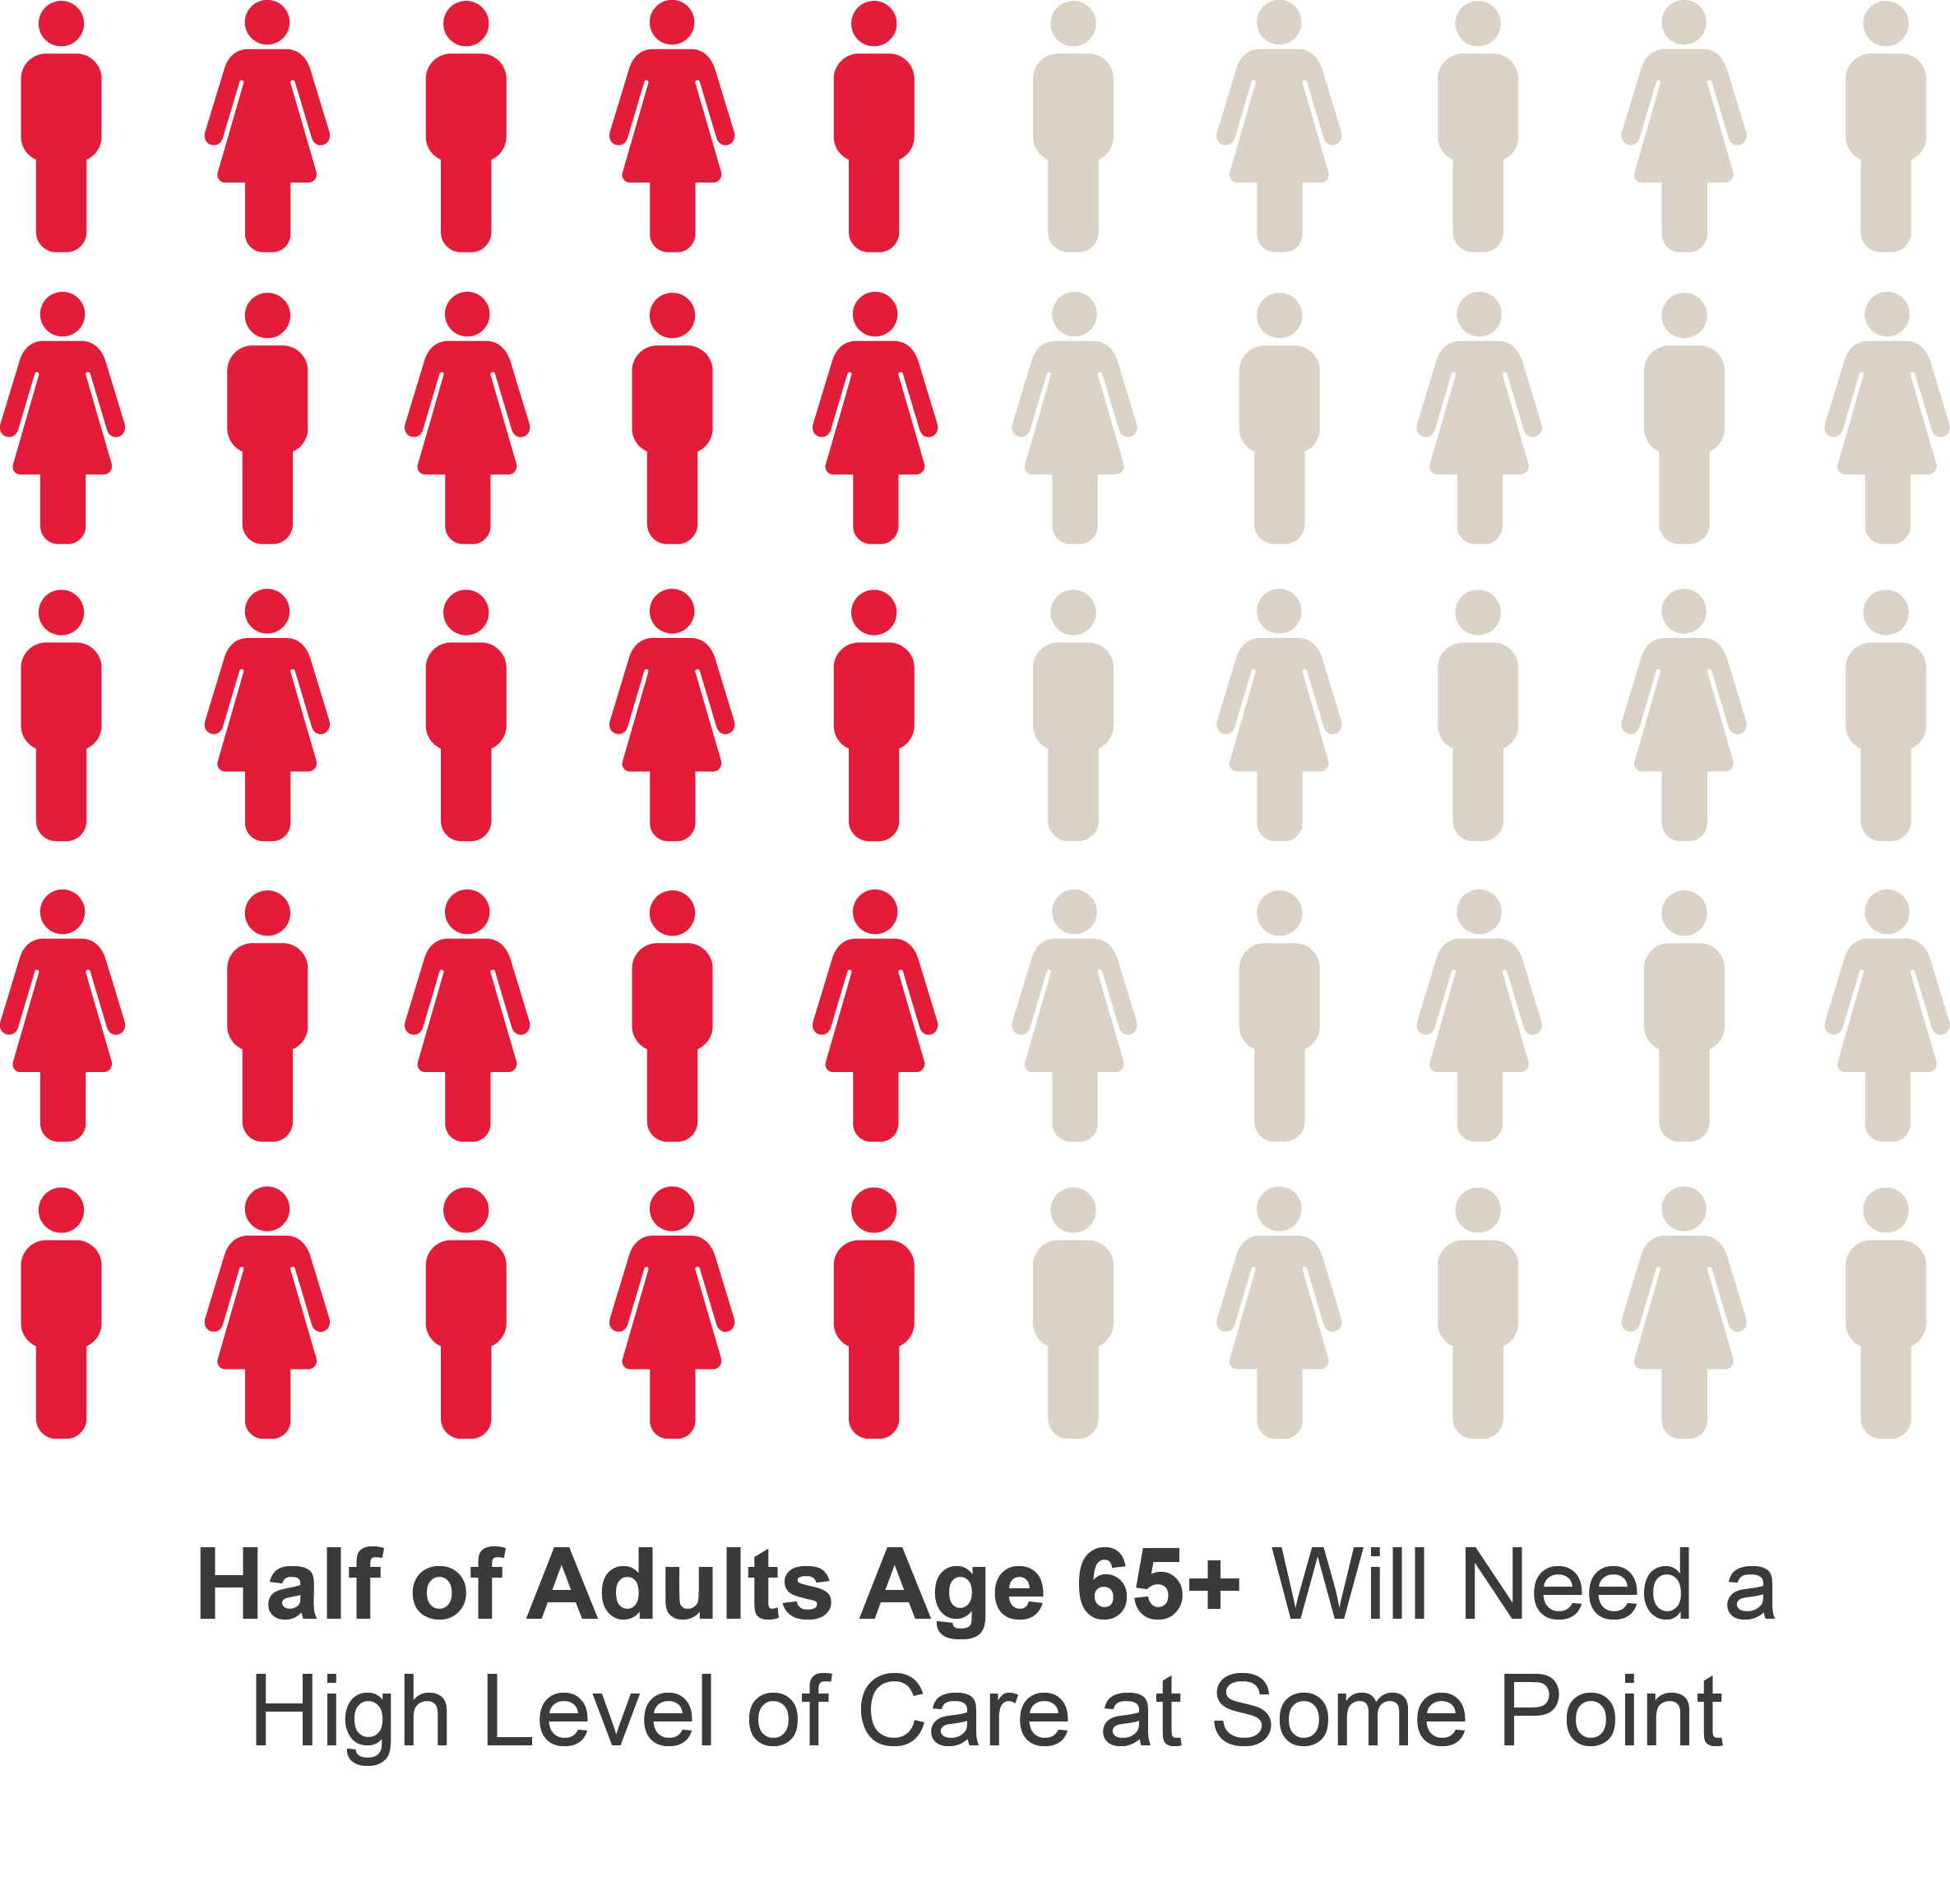
A Risk We All Face
Favreault & Dey (2015), Table 1
Notes:
Adults are defined as those turning 65 between 2015 and 2019
High level of care refers to needing help with two or more activities of daily living (ADLs), or severe cognitive impairment

Slide 6
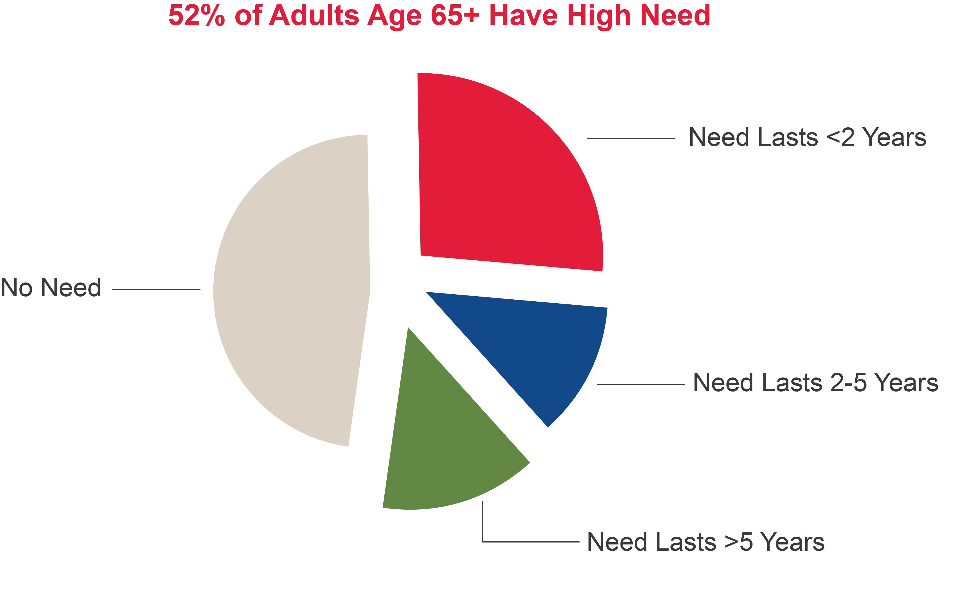
Older Adults Risk Many Years of High Need
Not high need
Favreault & Dey (2015), Table 1
6
Notes:
Adults are defined as those turning 65 between 2015 and 2019
High need refers to needing help with two or more activities of daily living (ADLs), or severe cognitive impairment
While not depicted directly on this slide, among those who do need care, about 30 percent will need it for less than a year, but 25 percent will need it for at least five years

Slide 7
More Than 3/4th of Medicare Beneficiaries with Complex Care Needs Live in Community
Medicare Beneficiaries with Functional Impairment, 2015
Source: Anne Tumlinson Innovations analysis of the 2015 Medicare Current Beneficiary Survey. Data includes all Medicare beneficiaries. Functional impairment in this display is measured at the “moderate” level.
Notes:
In 2015, there were 8.5 million Medicare beneficiaries who lived in a nursing home OR who lived in the community and received help with 1+ ADLs. Of that complex care need population:
1.9 million lived in nursing homes (22%)
0.6 million lived in independent or assisted living (7%)
6.0 million lived in private homes (71%)

Slide 8
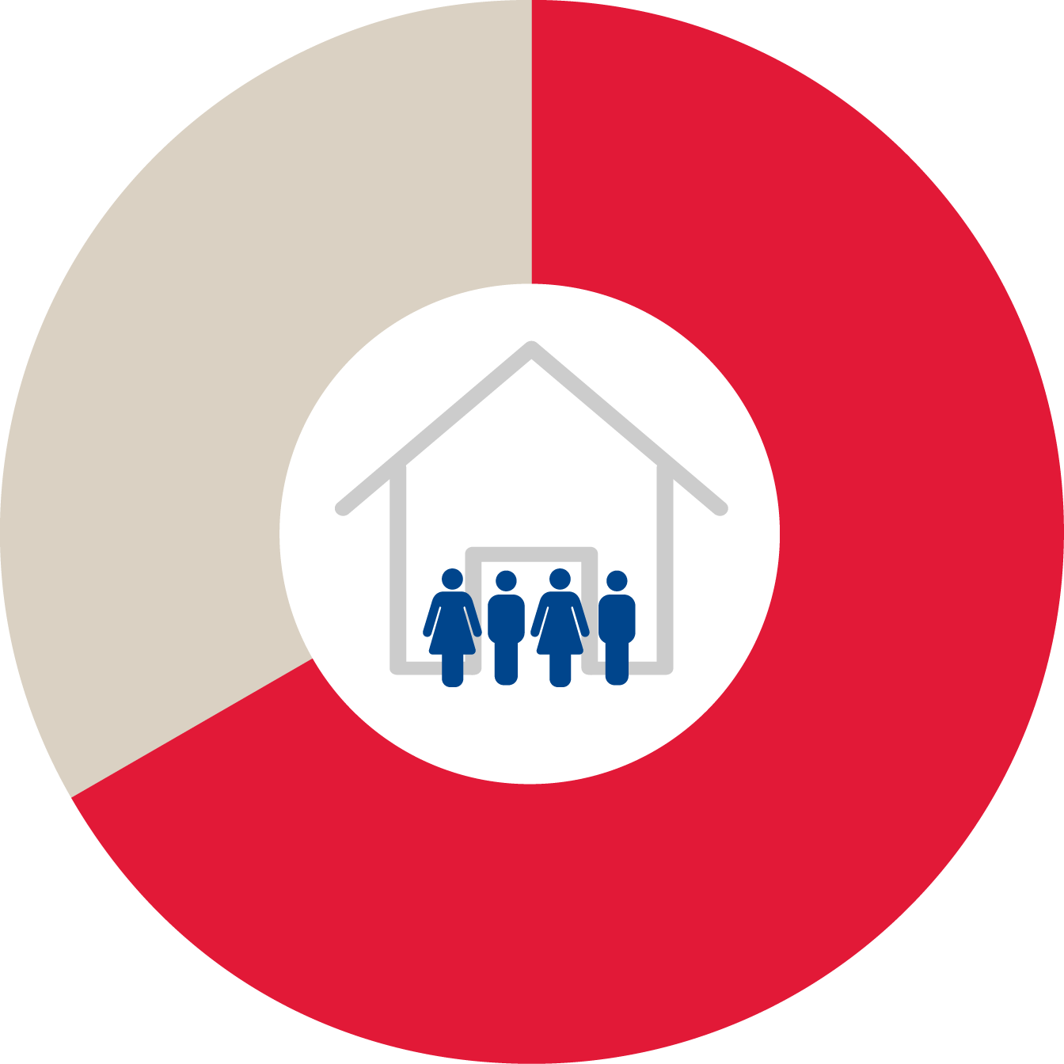
Older Adults Rely on Unpaid Caregivers
Nearly 2/3
of Older Adults in Community with Daily Living Needs Receive All Help from Unpaid Family and Friends
Note: Excludes individuals living in nursing homes Freedman & Spillman (2014), Table 2
8
Notes:
LTC needs are defined as receiving help with daily activities in the last month

Slide 9
Americans 40 & Under as Caregivers
1 in 3
Provide unpaid care to an adult relative or friend
Believe they will provide this care in the next 5 years
9

Slide 10
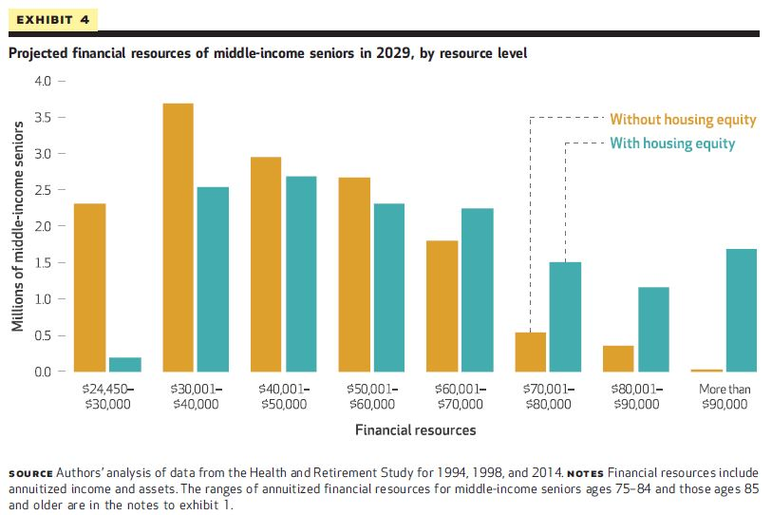
10

Slide 11
Functional Impairment Associated with High Medical Spending…
$10,507 = Full Medicare FFS population
Source: Anne Tumlinson Innovations analysis of the 2015 Medicare Current Beneficiary Survey. Data is limited to fee-for-service Medicare beneficiaries living in the community and excludes long-stay nursing home residents. Functional impairment in this display is measured at the “moderate” level.

Slide 12
Particularly True for Those with 3+ Chronic Conditions
Average Per Capita Medicare Spending, 2015
Source: Anne Tumlinson Innovations analysis of the 2015 Medicare Current Beneficiary Survey linked to Claims. Data is limited to fee-for-service Medicare beneficiaries living in the community; excludes long-stay nursing home residents. Functional impairment in this display is measured at the “moderate” level.
Notes:
Anne presents.
You might think that functional impairment is a proxy for chronic conditions
But actually, even among people who have three or more chronic conditions, having functional impairment, compared to not having it, doubles their healthcare spending.

Slide 13
Older Adults with Complex Care Needs in All Medicare Products
Percentage of Medicare Beneficiaries with Complex Care Needs (2015)
 | Fee-For-Service | Medicare Advantage
75+ years¹ | 34.5% | 38.2%
Moderate – Severe Functional Impairment² | 12% | 12%
Cognitive Impairment | 7% | 7%
Diagnosed with 3+ Chronic Conditions | 45% | 47%
Functional Impairment (FI) refers to the need for non-medical supports and services that help with basic activities of daily living (ADLs) like bathing, dressing, eating. It is highly associated with being over age 80 and having multiple chronic conditions
Note: Data excludes nursing home residents. Source: 1. America’s Health Insurance Plans. Medicare Advantage Demographics Report, 2015. June 2018. Accessed at: https://www.ahip.org/wp-content/uploads/2018/06/MADemographics_IssueBrief.pdf. 2. ATI. 2015 MCBS linked to claims.
Notes:
Bruce presents.
While we’ve known that the age of the population of the MA and FFS is roughly the same, we now have new data that shows that the functional, cognitive and chronic condition in MA also now mirror that of FFS.
Functional impairment, as you know, refers to someone’s challenges performing basic activities of daily living, and – as Anne is going to explain in a minute -- is strongly related to high healthcare spending which plans currently pay for.
Functional impairment is a status and chronic conditions are diseases. But you need to address both to manage unnecessary healthcare spending.
Many associate this problem solely with the dual population but the reality is they only represent a third of all people with functional limitations.
Now I’m going to turn it over to Anne to go over the data.

Slide 14
Most Medicare Beneficiaries with Functional Impairment Are Not On Medicaid
Share of Medicare Beneficiaries with Functional Impairment
Source: Anne Tumlinson Innovations analysis of the 2015 Medicare Current Beneficiary Survey. Data is limited to Medicare beneficiaries living in the community and excludes long-stay nursing home residents. Functional impairment in this display is measured at the “moderate” level.
Notes:
All insurance products represented on this slide (MA, SNP, Supp) – not just about DSNP

Slide 16
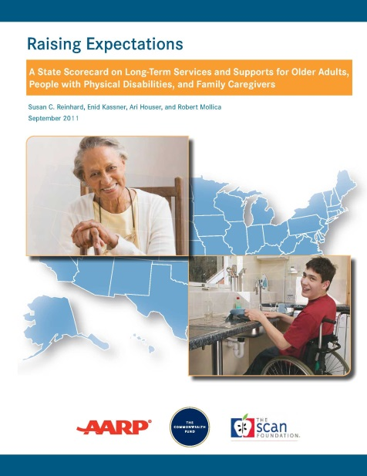
www.LongTermScorecard.org

Slide 17
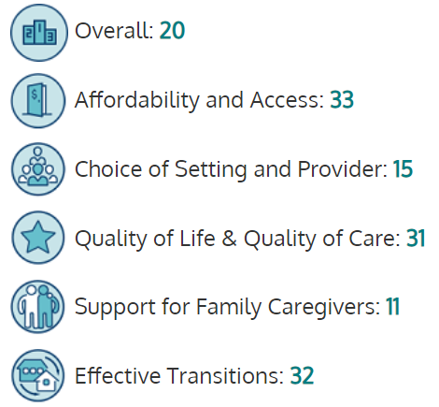
New York’s 2017 Results

Slide 18
Long-Term Care Financing Initiative
Co-funded by AARP & LeadingAge
Modeling work by Urban Institute/Milliman, Inc.
Technical assistance via Anne Tumlinson
Policy group engagement
AARP
Bipartisan Policy Center
LeadingAge Long-Term Care Financing Task Force
Long-Term Care Financing Collaborative
www.thescanfoundation.org/ltc-financing-initiative

Slide 19
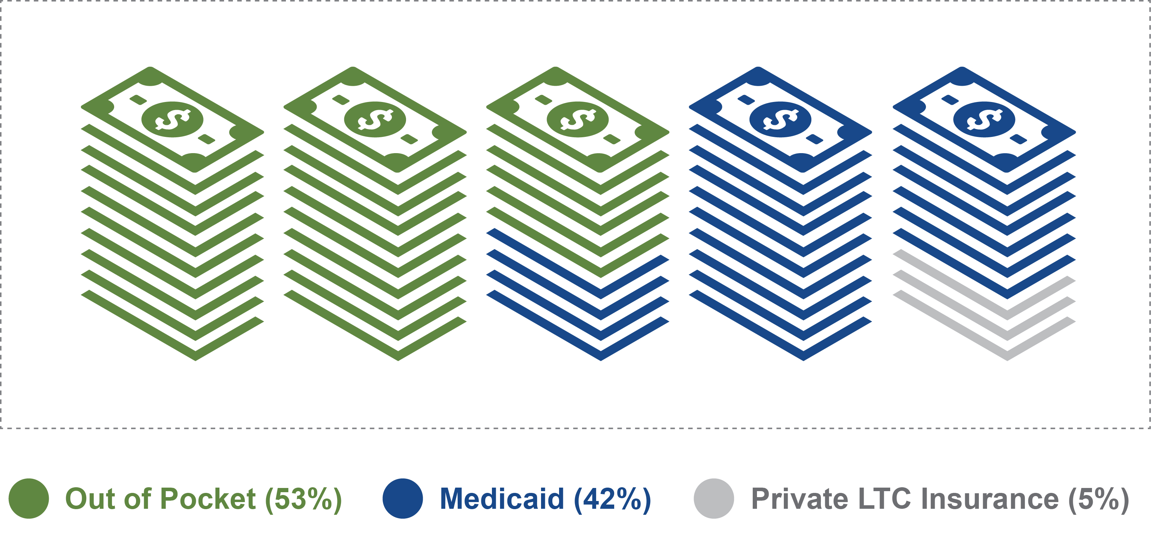
More Than Half of LTC Spending…OOP
Favreault & Johnson (2015), Table 15
Notes:
These percentages are based on the total annual projected spending in 2030, i.e., $382.4 billion.

Slide 20
Medicaid & Out of Pocket Cover Most Lifetime Average LTC Spending
Note: The estimated remainder of spending (Other) includes a combination of private LTC insurance and Medicare
Favreault & Dey (2015), Table 3A
Notes:
Cohort in data is older adults turning age 65 between 2015-2019
Lifetime spending for all services is $138,000. For Home and Residential Care, it is $72,800. For Nursing Home Care, it is $65,300
Although we are showing the small portion “Other” (e.g., Medicare), it relates to services such as Home Health, which is covered by Medicare in only limited circumstances and for a short duration

Slide 21
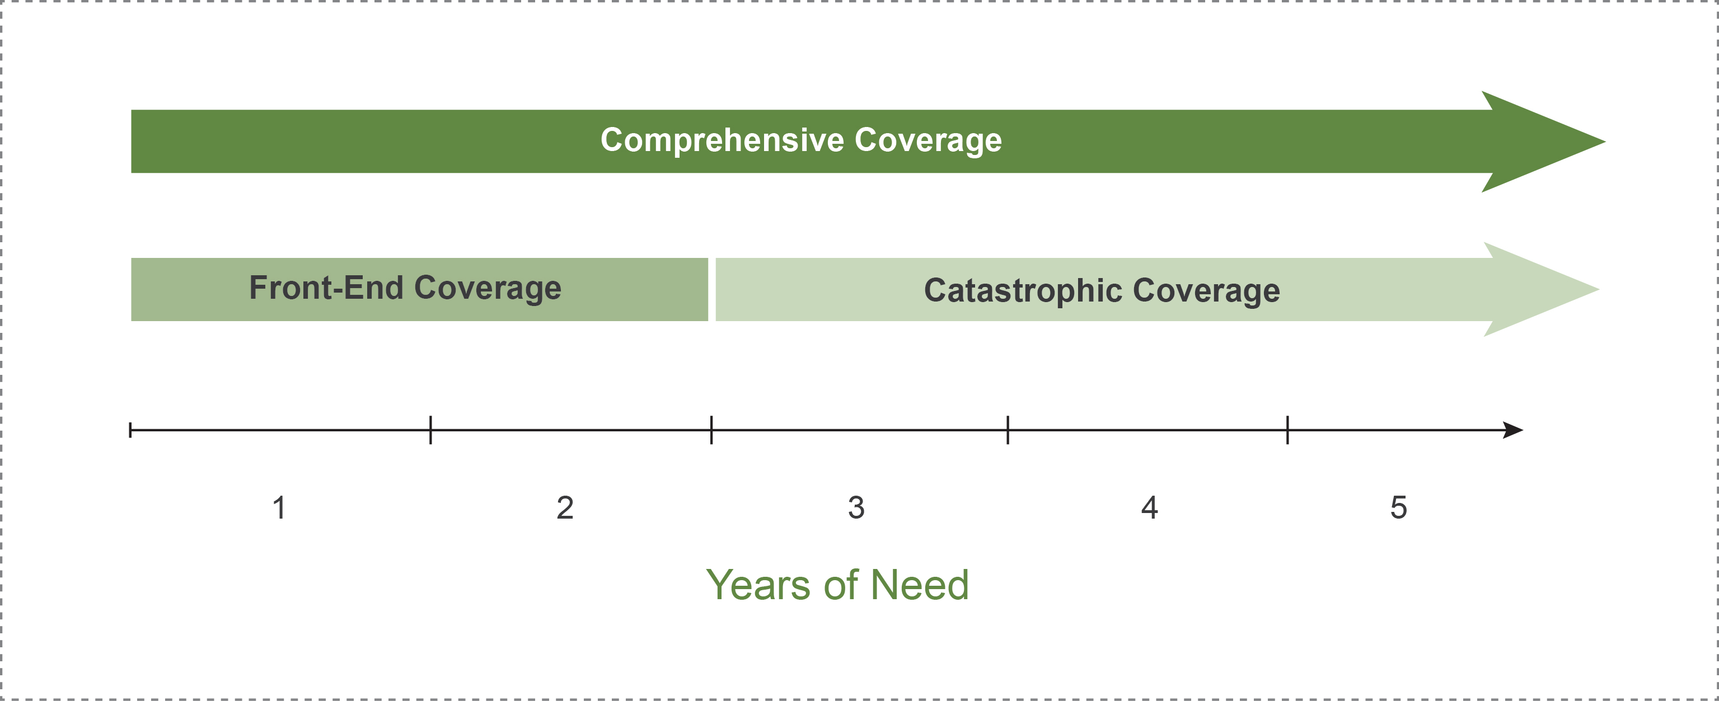
Mandatory & Voluntary: Three Approaches to Covering LTC Risk

Slide 22
Impacts of Mandatory Approaches
Favreault & Johnson (2015), Table 15
Notes:
Data is for projections in 2050
The options reduced spending in Medicaid and Out of Pocket in all categories, but the largest reductions for Medicaid and Out of Pocket are with the Catastrophic and Comprehensive approaches

Slide 23
Emerging Policy Recommendations
Private LTC Insurance improvements
Medicare Advantage supplemental benefits
Medicare respite benefit
Catastrophic coverage
Person-centered Medicaid flexibility

Slide 24
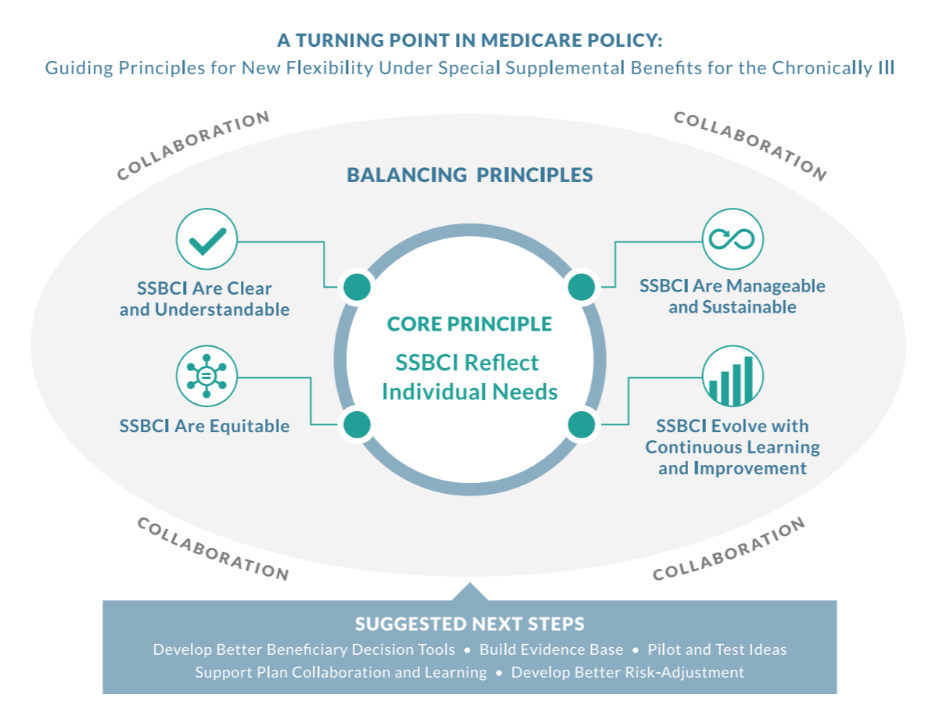
A Turning Point in Medicare Policy

Slide 25
State Tools to Address Daily Living Needs
State Master Plan for Aging
Medicaid policy and contract oversight
Insurance regulation (e.g., Medicare Advantage)
Tax policy
Employer benefits policy
Consumer affairs regulation
Professional licensure/certification regulation
Housing and transportation policy (e.g., zoning)

Slide 26
Gretchen’s 3 Takeaways
Demographics + daily functioning shape the new innovation landscape for aging Americans
The time for addressing daily living needs for an aging population = NOW
States have many tools to address daily living needs
Notes:
Bruce opens the discussion.
Today Medicare Advantage plans serve a complex care population, which now mirrors FFS, and opens up an array of opportunities for those who care for them.
The SCAN Foundation and others are documenting how health plans are already emerging as innovators in high value care delivery for this population.
Increasing needs and plan interest to respond, combined with new MA flexibility, will only enhance demand for information and innovation.
We are committed to informing all stakeholders on this issue and wish to collaborate to prioritize research, supplement your work, and contribute to the development of MA plan enhancements in this area that respond to growing populations/needs.

Slide 27
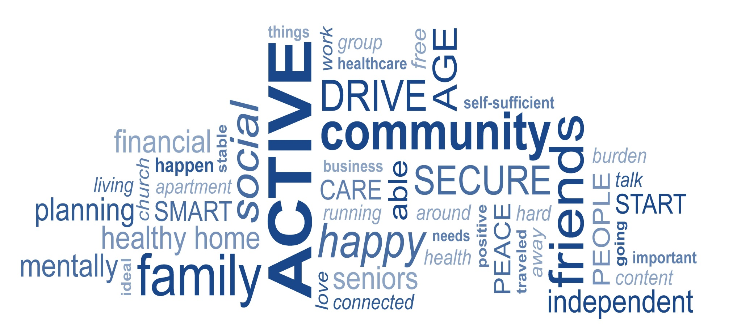
The Real Policy Goal…

Slide 28
Sign up for email alerts at www.TheSCANFoundation.org
Follow us on Twitter
@TheSCANFndtn
Find us on Facebook
The SCAN Foundation
Our Vision: A society where older adults can access health and supportive services of their choosing to meet their needs.
Our Mission:
To advance a coordinated and easily navigated system of high-quality services for older adults that preserve dignity and independence.
28

