Slide 1

NYS Prevention Agenda 2019-2024
Presentation to NYS Public Health and Health Planning Council Public Health Committee
Jo Ivey Boufford, Chair, Public Health Committee
Brad Hutton, Deputy Commissioner for Public Health
Sylvia Pirani, Prevention Agenda Coordinator
December 3, 2018

Slide 2
NYS Prevention Agenda
Goal is improved health status of New Yorkers and reduction in health disparities through increased emphasis on prevention.
Call to action to broad range of stakeholders to collaborate at the community level to assess local health status and needs; identify local health priorities; and plan, implement and evaluate strategies for local health improvement.
Led by Ad Hoc Committee appointed by the NYS Public Health and Health Planning Council.

Slide 3
History of the New York State Prevention Agenda
Pre-Prevention Agenda
Prevention Agenda 2008 - 2012
10 Priorities including access to care
Prevention Agenda 2013-2018
5 priorities focused on prevention
LHDs and hospitals strongly urged to collaborate and co-develop shared assessments and plans.
NYS was the 28th healthiest state
LHDs and Hospitals were asked to complete collaborative assessments and plans aligned with Prevention Agenda.
Development and implementation of community health improvement efforts proved challenging.
Non-profit hospitals completed community service plans (CSPs) as per Article 28 of PH Law. Plans were retrospective descriptions of actions taken to support community health.
NY was the 15th healthiest state
NYSDOH provided feedback and required annual updates to monitor progress.
Hospitals asked to report community benefit spending and to link community benefit spending with implementation of Prevention Agenda interventions and with DSRIP investments.
NYS Public Health Priorities described in Communities Working Together for a Healthier New York (led by PHHPC).
Local health departments completed community health assessments (CHAs) and municipal public health service plans as per Article 6 of PH Law. Assessments and plans were completed by each LHD by itself.

Slide 4
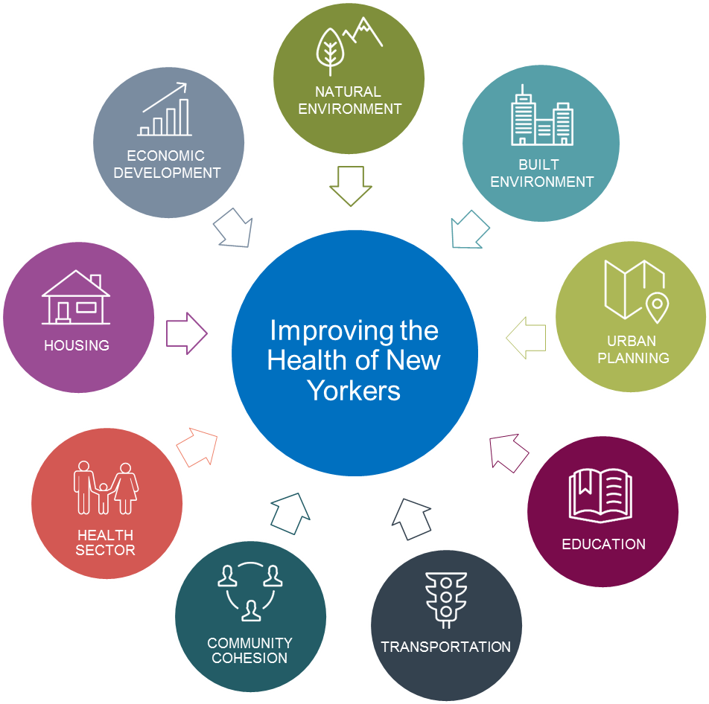

Traveling Together…
Health Across All Policies
Age-Friendly NYS
AARP
NYS PREVENTION AGENDA 2019-2024
NYAM

Slide 5
Process for Updating Prevention Agenda for 2019-2024
February – April, 2018
Assessed health status and demographic changes, progress on Prevention Agenda objectives and key challenges, and progress on local action
Ad Hoc Committee members hosted 20+ meetings to obtain feedback
200 individuals/organizations completed survey to provide feedback.
May – September, 2018
Ad Hoc Committee met to finalize focus areas and goals based on stakeholder feedback
Committees developed priority specific action plans
Used established committees where possible
NYS Agencies integrated into effort: OMH, OASAS, Ag and Markets, Aging, DEC, NYSERDA, Dept. of State, NYSED
October – December, 2018
State Agency staff completed priority specific plans based on feedback from Ad Hoc Committee
PHC and PHHPC meet to review and approve updated Plan
NYS will use updated Prevention Agenda to launch next cycle of local planning

Slide 6
NYS Health Assessment:
Changing Demographics
Population of NYS is growing, especially the number of older New Yorkers.
New Yorkers are becoming more diverse.
17% of New York’s families live in poverty.

Slide 7
Indicators not met
Indicators met
As of September 2018
https://health.ny.gov/preventionagendadashboard

Slide 8
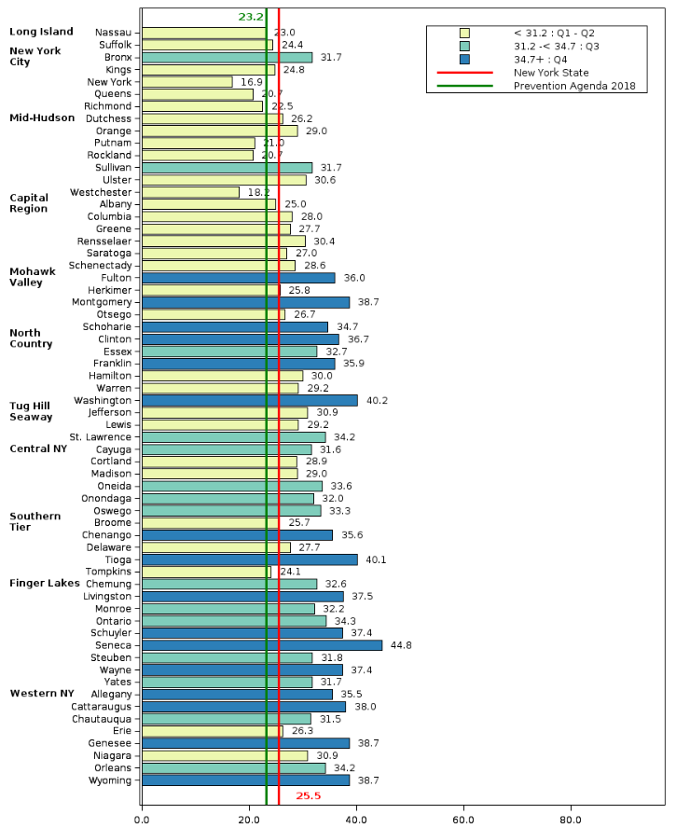
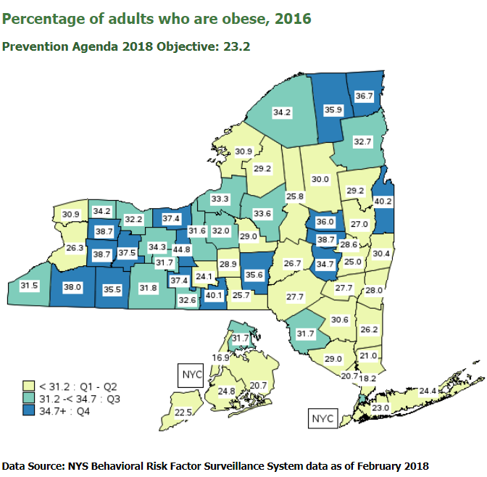

Slide 9
NYS Health Assessment:
Summary of Health Issues
Chronic diseases continue to be a major burden including heart diseases, cancers, diabetes, and asthma.
We are making good progress in some maternal and infant health indicators including teen pregnancy and breastfeeding but more work to be done to address the disparities related to infant mortality, preterm birth, and maternal mortality.
We are on the path to end AIDS, but STIs and Hep C remain concerns.
Drinking water quality has become a leading priority and New York State is leading the nation.
Most importantly, opioid overdose is a major issue that is contributing to declining life expectancy.
Notes:
In summary….

Slide 10
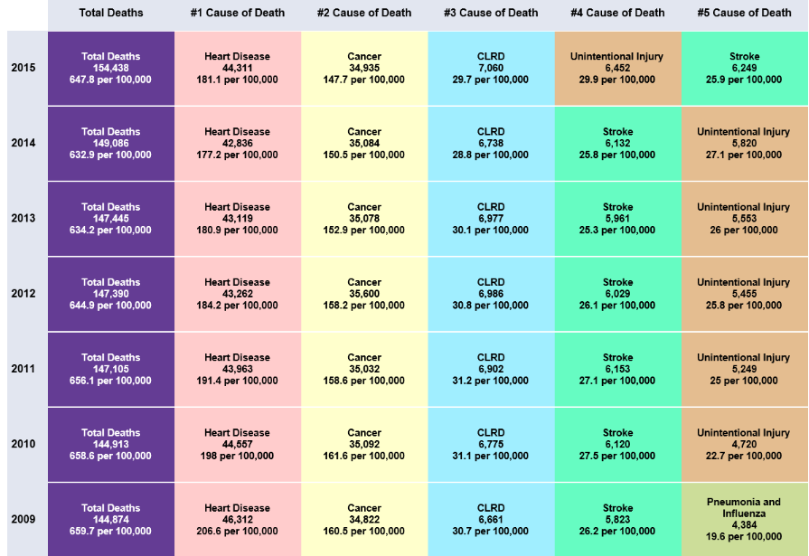
Leading causes of death, New York State, 2009-2015
Data Source: NYS Vital Statistics

Slide 11
Overdose deaths involving any opioid, age-adjusted rate per 100,000 population,
by region, New York State 2010-2016
Data Source: CDC WONDER; accessed August 2018

Slide 12
Stakeholder Feedback Summary
  Overall support for priorities, focus areas and goals
  Include actionable interventions to address emerging public health challenges:
    Vaping and e-cigs, Gun Violence, Adverse Childhood Experiences, Opioids, Food Security…
  Include actionable interventions related to health and well-being of older adults in each priority area
  Be specific about how to reduce disparities and address challenges in low income and minority communities in each priority:
    STIs, HIV, Maternal Mortality, air and water quality …
  Promote Well Being is an important goal for both the Mental Health priority area and as a cross cutting principle.
  Need to keep it simple!

Slide 13
Prevention Agenda 2019-24 Vision:
New York is the Healthiest State
for People of all Ages

Slide 14
Prevention Agenda 2019-2024
Priority Areas
Prevent Chronic Diseases
Promote a Healthy and Safe Environment
Promote Healthy Women, Infants and Children
Promote Well-being and Prevent Mental and
Substance Use Disorders
Prevent Communicable Diseases

Slide 15
Action Plan for Each Priority Area
Focus Areas
  Goals
    Measurable Objective(s)
    Evidence Based Interventions
    Resources for Implementation
    Identification of populations/age groups affected
    Identification of organizations that play leading or supporting roles

Slide 16
Prevent Chronic Diseases
Focus Area 1: Healthy Eating and Food Security Overarching Goal: Reduce obesity and the risk of chronic diseases
Goal 1.1: Increase access to healthy and affordable foods and beverages
Goal 1.2: Increase skills and knowledge to support healthy food and beverage choices
Goal 1.3: Increase food security
Focus Area 2: Physical Activity Overarching Goal: Reduce obesity and the risk of chronic diseases
Goal 2.1: Improve community environments that support active transportation and recreational physical activity for people of all ages and abilities
Goal 2.2: Promote school, child care, and worksite environments that support physical activity for people of all ages and abilities
Goal 2.3: Increase access, for people of all ages and abilities, to safe indoor and/or outdoor places for physical activity
Focus Area 3: Tobacco Prevention
Goal 3.1: Prevent initiation of tobacco use, including combustible tobacco and electronic vaping products (electronic cigarettes and similar devices) by youth and young adults
Goal 3.2: Promote tobacco use cessation, especially among populations disproportionately affected by tobacco use including: low SES; frequent mental distress/substance use disorder; LGBT; and disability
Goal 3.3: Eliminate exposure to secondhand smoke and exposure to secondhand aerosol/emissions from electronic vapor products
Focus Area 4: Preventive Care and Management
Goal 4.1: Increase cancer screening rates for breast, cervical, and colorectal cancer
Goal 4.2: Increase early detection of cardiovascular disease, diabetes, prediabetes and obesity
Goal 4.3: Promote the use of evidence-based care to manage chronic diseases
Goal 4.4: Improve self-management skills for individuals with chronic conditions

Slide 17
Promote a Healthy and Safe Environment
Focus Area 1: Injuries, Violence and Occupational Health
Goal 1.1: Reduce falls among vulnerable populations
Goal 1.2: Reduce violence by targeting prevention programs particularly to highest risk populations
Goal 1.3: Reduce occupational injuries and illness
Goal 1.4: Reduce traffic related injuries for pedestrians and bicyclists
Focus Area 2: Outdoor Air Quality
Goal 2.1: Reduce exposure to outdoor air pollutants
Focus Area 3: Built and Indoor Environments
Goal 3.1: Improve design and maintenance of the built environment to promote healthy lifestyles, sustainability, and adaptation to climate change
Goal 3.2: Promote healthy home and school environments
Focus Area 4: Water Quality
Goal 4.1: Protect water sources and ensure quality drinking water
Goal 4.2: Protect vulnerable waterbodies to reduce potential public health risks associated with exposure to recreational water
Focus Area 5: Food and Consumer Products
Goal 5.1: Raise awareness of the potential presence of chemical contaminants and promote strategies to reduce exposure
Goal 5.2: Improve food safety management

Slide 18
Promote Healthy Women, Infants and Children
Focus Area 1: Maternal & Women’s Health
Goal 1.1: Increase use of primary and preventive health care services by women of all ages, with a focus on women of reproductive age
Goal 1.2: Reduce maternal mortality and morbidity
Focus Area 2: Perinatal & Infant Health
Goal 2.1: Reduce infant mortality and morbidity
Goal 2.2: Increase breastfeeding
Focus Area 3: Child & Adolescent Health
Goal 3.1: Support and enhance children and adolescents’ social-emotional development and relationships
Goal 3.2: Increase supports for children and youth with special health care needs
Goal 3.3: Reduce dental caries among children
Focus Area 4: Cross Cutting Healthy Women, Infants, & Children
Goal 4.1: Reduce racial, ethnic, economic, and geographic disparities in maternal and child health outcomes and promote health equity for maternal and child health populations

Slide 19
Promote Well-Being and Prevent Mental and
Substance Use Disorders
Focus Area 1: Promote Well-Being
Goal 1.1: Strengthen opportunities to build well-being and resilience across the lifespan
Goal 1.2: Facilitate supportive environments that promote respect and dignity for people of all ages
Focus Area 2: Prevent Mental and Substance Use Disorders
Goal 2.1: Prevent underage drinking and excessive alcohol consumption by adults
Goal 2.2: Prevent opioid and other substance misuse and deaths
Goal 2.3: Prevent and address adverse childhood experiences (ACEs)
Goal 2.4: Reduce the prevalence of major depressive disorders
Goal 2.5: Prevent suicides
Goal 2.6: Reduce the mortality gap between those living with serious mental illness and the general population

Slide 20
Prevent Communicable Diseases
Focus Area 1: Vaccine-Preventable Diseases
Goal 1.1: Improve vaccination rates
Goal 1.2: Reduce vaccination coverage disparities
Focus Area 2: Human Immunodeficiency Virus (HIV)
Goal 2.1: Decrease HIV morbidity (new HIV diagnoses)
Goal 2.2: Increase viral suppression
Focus Area 3: Sexually Transmitted Infections (STIs)
Goal 3.1: Reduce the annual rate of growth for STIs
Focus Area 4: Hepatitis C Virus (HCV)
Goal 4.1: Increase the number of persons treated for HCV
Goal 4.2: Reduce the number of new HCV cases among people who inject drugs
Focus Area 5: Antibiotic Resistance and Healthcare-Associated Infections
Goal 5.1: Improve infection control in healthcare facilities
Goal 5.2: Reduce infections caused by multidrug resistant organisms and C. difficile
Goal 5.3: Reduce inappropriate antibiotic use

Slide 21
An example……

Slide 22
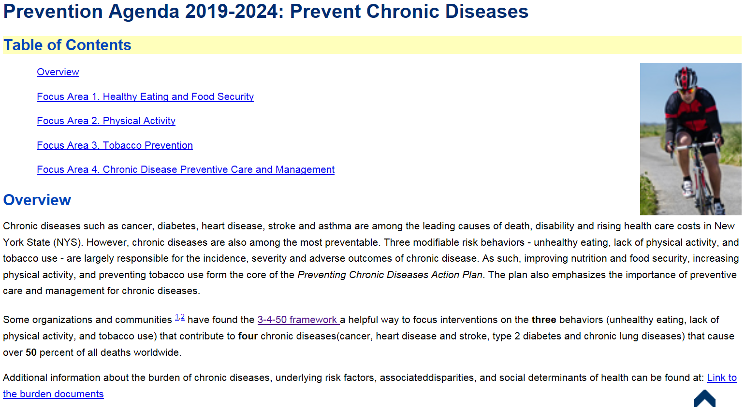


Slide 23
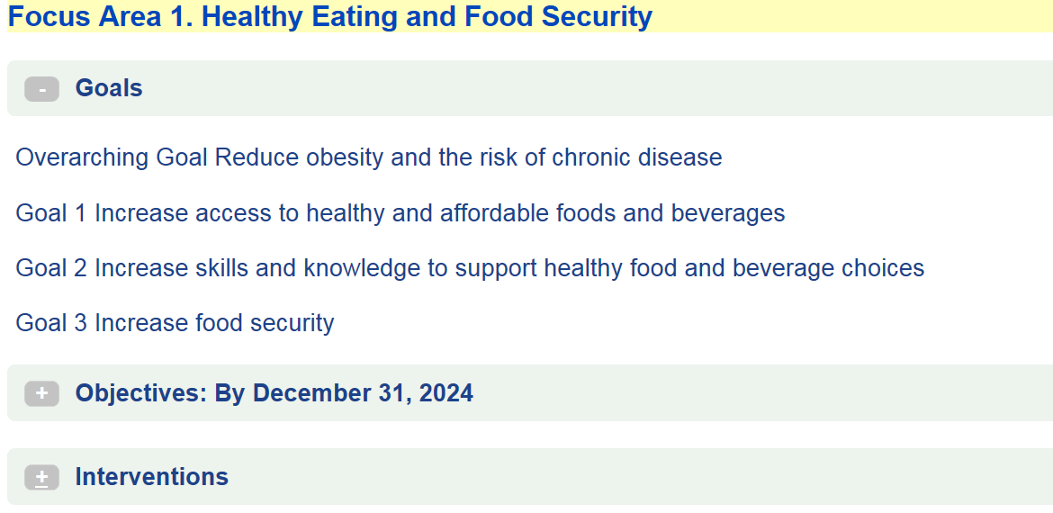

Slide 24
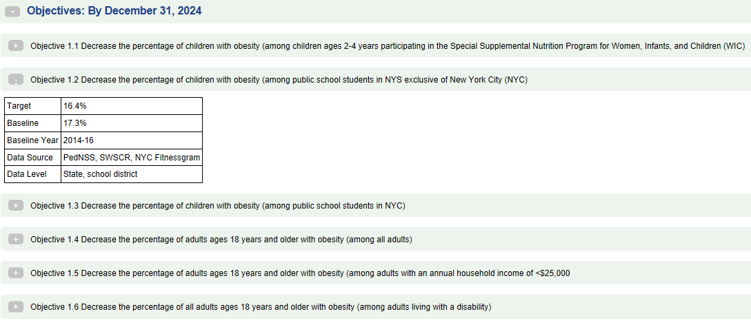

Slide 25
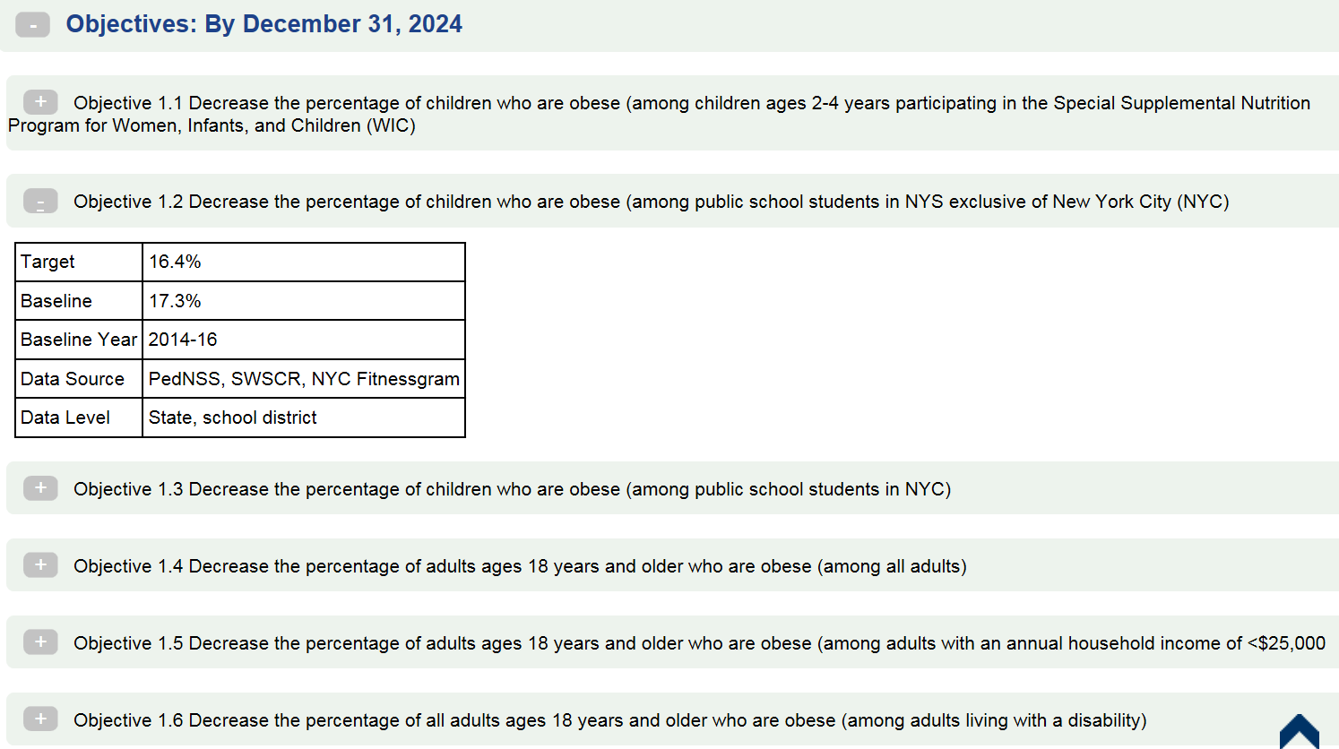
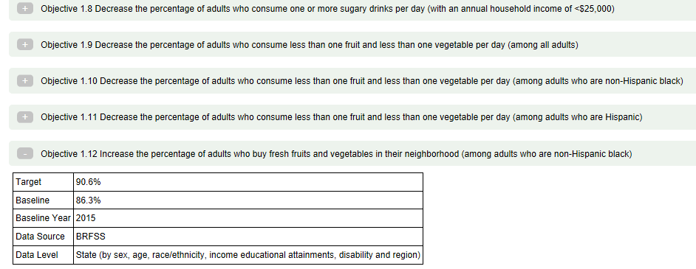

Slide 26
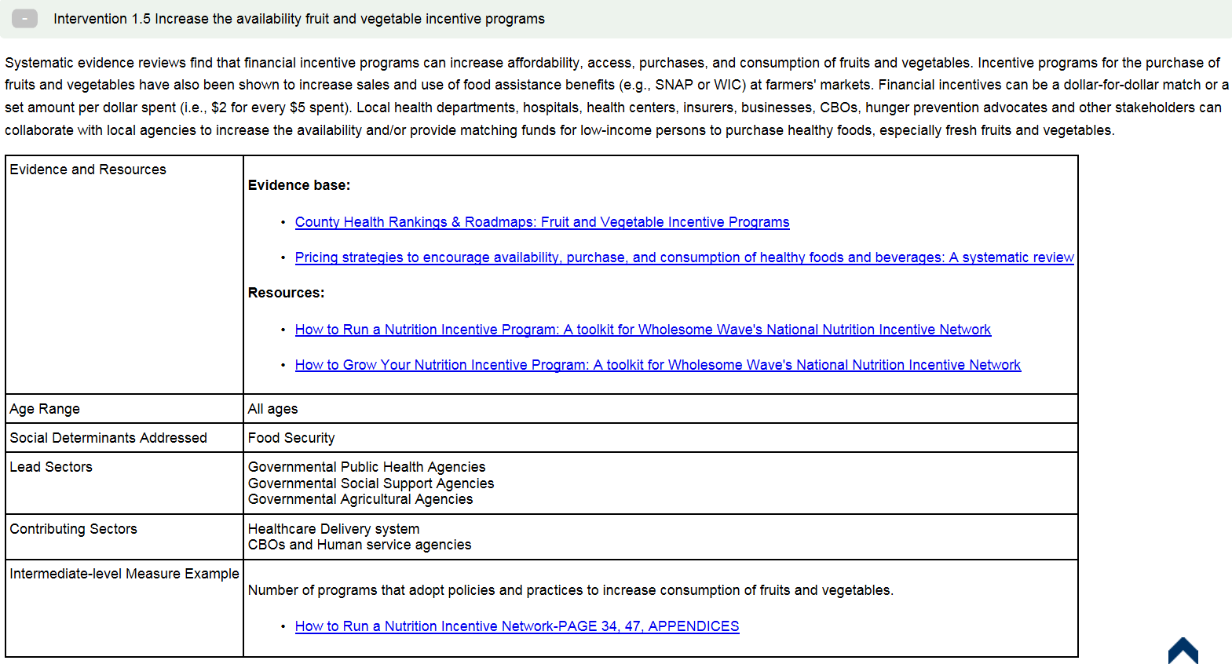

Slide 27
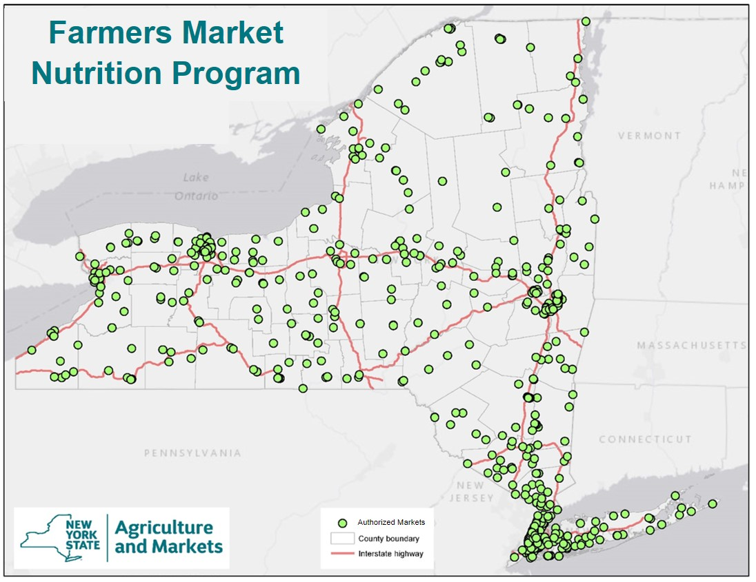
Resources that make local food more affordable:
  Farmers Market Nutrition Program Checks
  SNAP
    FreshConnect
    Health Bucks
    Double Up Food Bucks
https://www.agriculture.ny.gov/AP/agservices/fmnp/fmnp-authorized-markets.html

Slide 28
Community Health Improvement Planning in NYS
Pre-Prevention Agenda
Local health departments completed community health assessments (CHAs) and municipal public health service plans as per Article 6 of PH Law.
Prevention Agenda 2008 - 2012
LHDs asked to conduct a CHA and to collaborate with hospitals to identify shared local priorities aligned with Prevention Agenda for action to be described in hospital CSPs.
Prevention Agenda 2013-2018
LHDs asked to collaborate with hospitals and other partners on development of CHA and CHIPs and in 2016 strongly encouraged to do ONE plan.
Development and implementation of community health improvement efforts challenging.
Non profit hospitals completed community service plans (CSPs) as per Article 28 of PH Law. Plans were retrospective descriptions of actions taken to support community health.
CSPs became prospective plans.
Hospitals asked to reflect collaborative CHA/CHP efforts in their CSP.
NYSDOH provided feedback to both hospitals and LHDs and requiring annual updates
Aligned guidance with PHAB and ACA requirements.
Hospitals asked to report community benefit spending and to link community benefit and DSRIP spending with implementation of Prevention Agenda interventions.

Slide 29
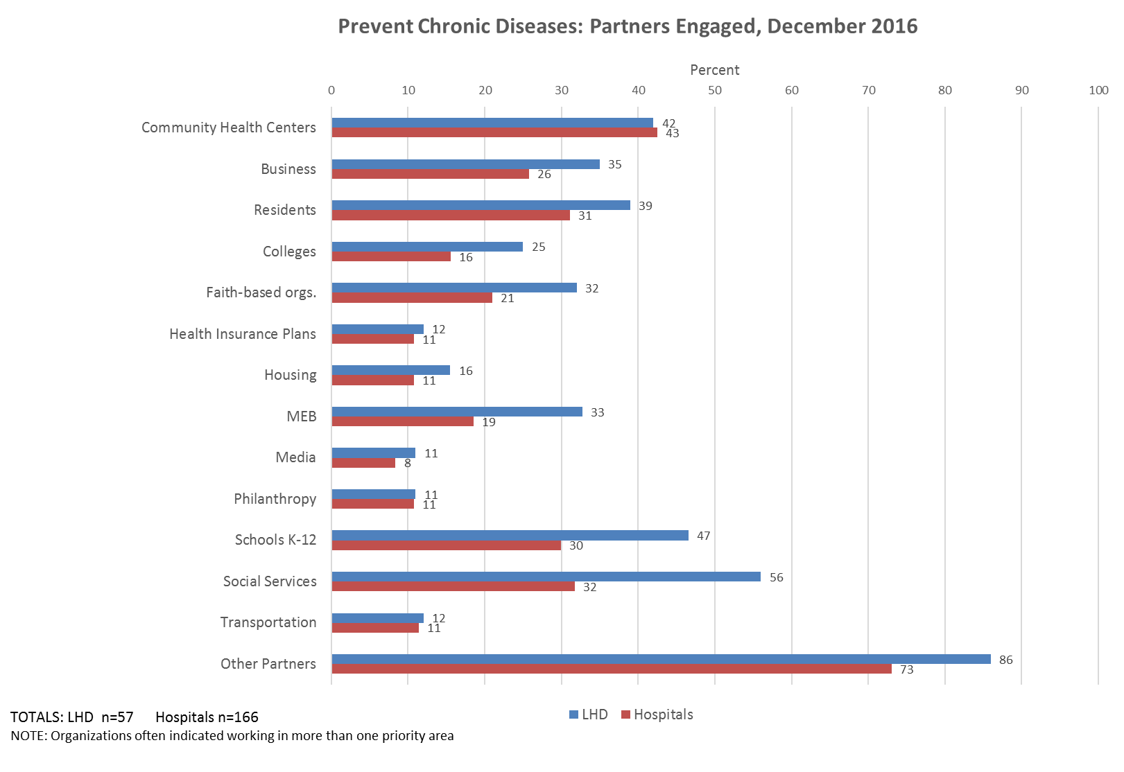
Prevent Chronic Diseases: Partners Engaged, December 2016
Mental, Emotional, and Behavioral

Slide 30
Source: 2016-2018 Workplans
* Local health departments conduct many interventions in this area, but are not counting them as collaborative Prevention Agenda interventions.

Slide 31
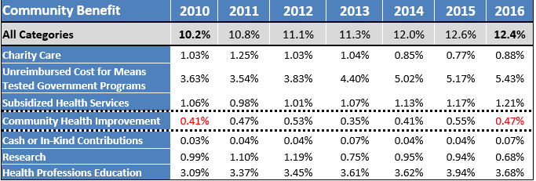
Hospital Community Benefit Investment
In 2016, community benefit accounted for 12.4% of NYS hospitals’ total expenses, including 0.47% of expenses for community health improvement.
Percentage of Total Operating Expenses among Hospitals in New York State
New York State Department of Health Office of Public Health Practice – Data current as of August 2018

Slide 32
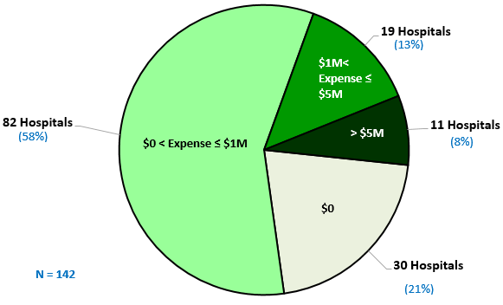
Uneven Spending on Community Health Improvement Services by Non-Profit Hospitals, NYS 2016

Slide 33
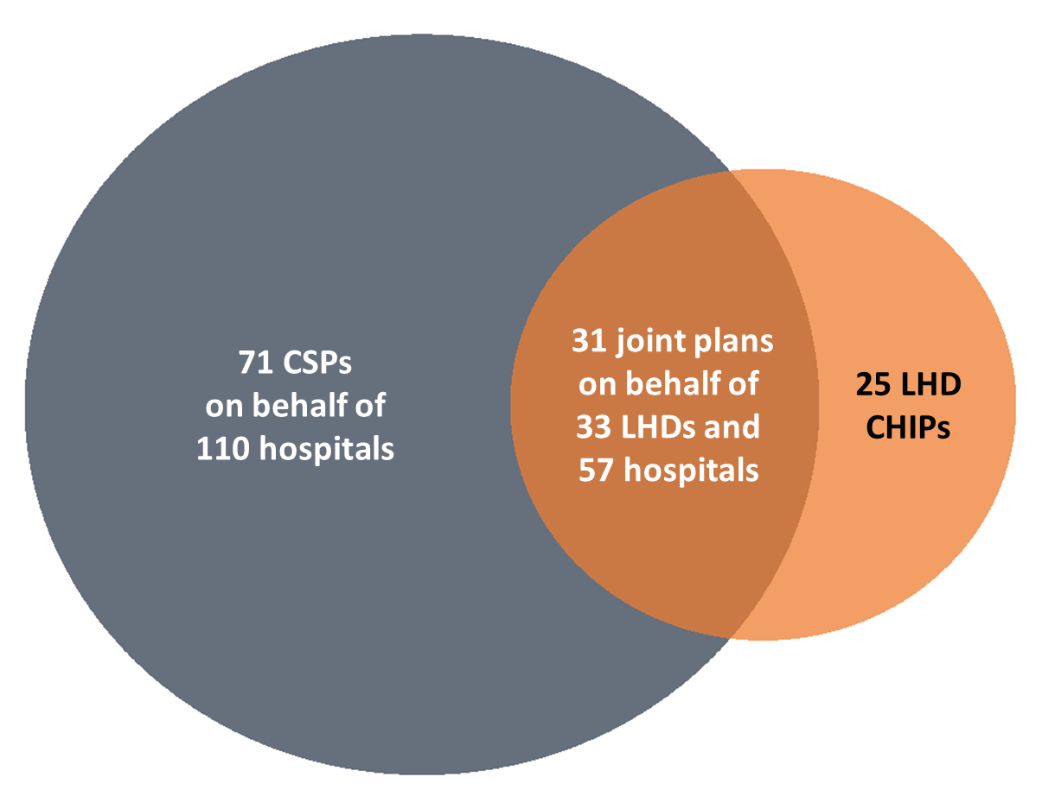
Prevention Agenda will continue to be blueprint for Local Community Health Improvement
127 plans by 58 LHDs and 167 Hospitals
Local health departments, hospitals and other community organizations will conduct local collaborative community health assessment and improvement planning again starting 2019.
LHDs and hospitals will be strongly encouraged to develop single collaborative plan – challenging for multi-county big hospital systems.
Hospitals will be asked to describe how they are investing their resources to support local Prevention Agenda efforts.
Hospitals asked to connect the PA to their Certificate of Need application process.

Slide 34
Coming Soon:
2019 Population Health Summit!
February 28, 2019 in Albany
Celebrate progress, learn about updated Prevention Agenda, highlight Health Across all Policies and Healthy Aging efforts
Connect communities working on common Prevention Agenda priorities to advance collaborations between public health, hospitals, and other sectors
Sponsors:
NY Academy of Medicine
Institute for Family Health
NYU Langone Medical Center
United Hospital Fund
Primary Care Development Corporation
HRI/NYSDOH
NYS Health Foundation
Health Foundation of Western and Central NY
HANYS
NYSACHO
NYS Podiatric Medical Association
SUNY Albany School of Public Health
NYS Public Health Association
IPRO

