Slide 1
Retreat of the Public Health and Health Planning Council September 6 - 8, 2017 Tarrytown NY
Department of Health
Public Health and Health Planning Council
Looking Back and Looking Forward
Jeffrey Kraut, Chair

Slide 2
Mission
We protect, improve and promote the health, productivity and well being of all New Yorkers.
Vision
New Yorkers will be the healthiest people in the world - living in communities that promote health, protected from health threats, and having access to quality, evidence-based, cost-effective health services.
Values
Dedication to the public good, Innovation, Excellence, Integrity, Teamwork, Efficiency

Slide 3
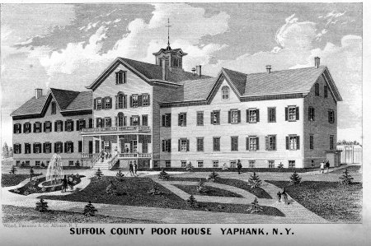
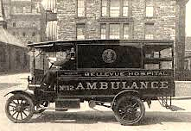
Origins of the New York State Public Health Council
1857
Senate Recommends a Commission to Oversee Charitable Institutions
1867
Establish State Commission of Public Charities
1896
Board of Charities Commission vested with Oversight Powers
1901
Department of Health Established
1913
Public Health Council Established
1927
Department of Mental Hygiene Established
1850
1860
1870
1880
1890
1900
1910
1920
1930
Notes:
The predecessor of today’s hospitals and nursing homes the almshouse (poor house).
Almshouses existed in almost all cities of moderate size and were run by the local government.
The Wadsworth Center evolved from the state's Antitoxin Laboratory, established in 1901 to standardize and manufacture antitoxin, the prevailing treatment for communicable diseases such as diphtheria and anthrax. In 1914, the organization was designated the Division of Laboratories and Research, and Augustus B. Wadsworth was named director. The Antitoxin Laboratory was housed in a modest, two-story brick building in a residential neighborhood on Yates Street in Albany, New York. Horses used in the production of antitoxin were stabled there, necessitating that any sterile work be conducted in space sublet from the nearby Bender Hygienic Laboratory.
Smallpox. Cholera. Typhoid. Tuberculosis. At the turn of the 20th century, death frequently arrived in these guises. For infants and children, though, no infection was feared more than diphtheria, whose microbial toxin coursed through young bodies, ultimately strangling its victims. In New York City alone in the 1890s, there were some 1,000 deaths a year from the disease.
As the germ theory of disease emerged from Europe and took hold in the U.S., the first science-based remedies for infectious diseases were made possible. Among the earliest successes was antitoxin for the treatment of diphtheria. In 1901, the very year that the first Nobel Prize for Medicine or Physiology was awarded to the German microbiologist Emil Behring for his discoveries that led to the development of diphtheria antitoxin, New York State established a laboratory to produce and distribute the remedy. The Antitoxin Laboratory is the forerunner of today's Wadsworth Center laboratories.

Slide 4
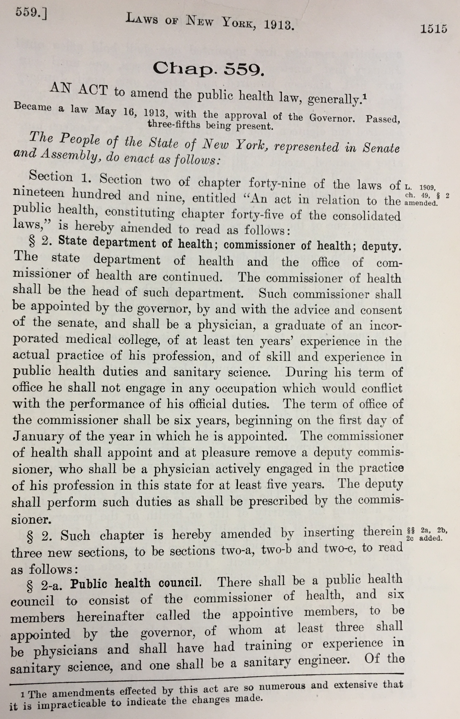
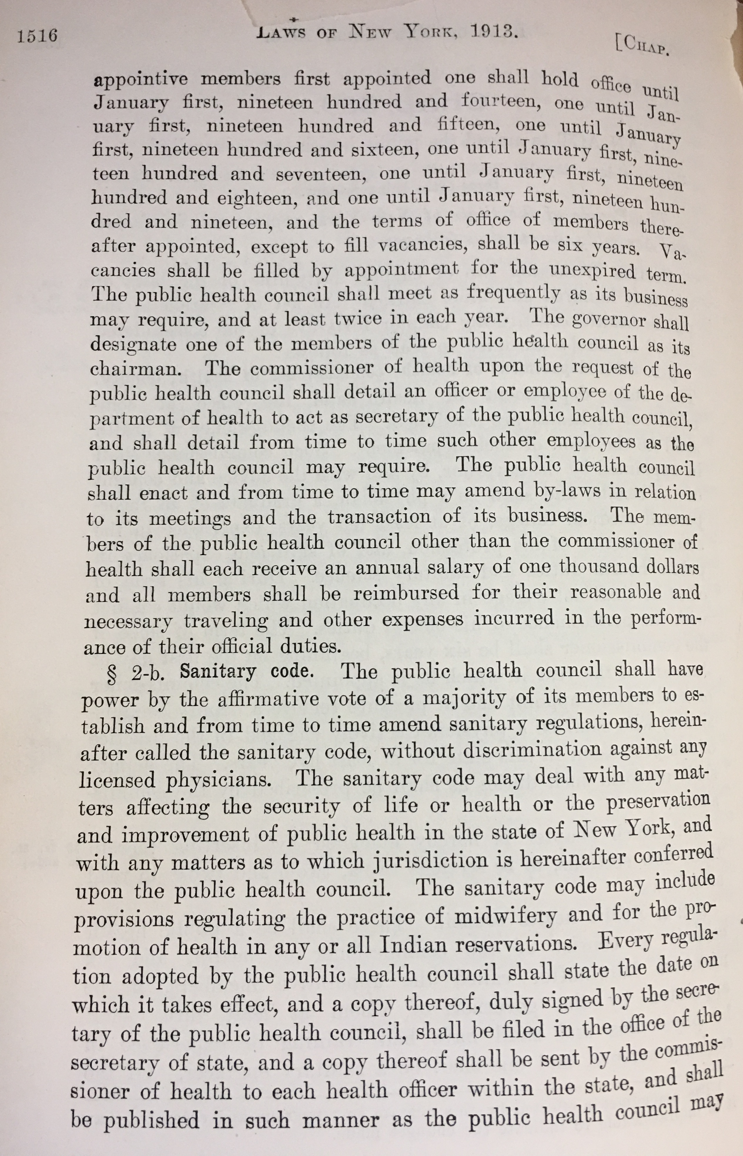
“Council… shall, at the request of the commissioner of health, consider any matter relating to the preservation and improvement of health , and may advise the commissioner thereon; and it may from time to time submit to the commissioner any recommendations with it may deem wisely.”

Slide 5
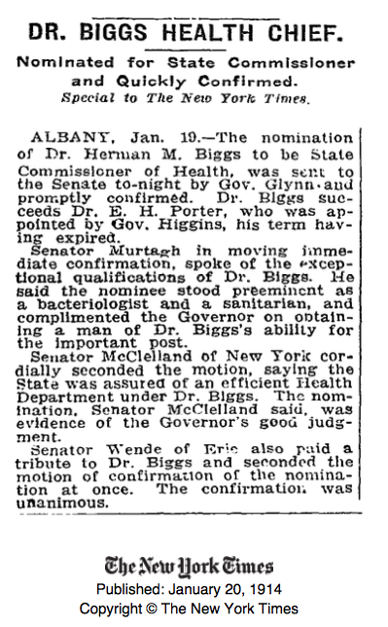

Slide 8
Evolution of the Public Health and Health Planning Council
1947
Joint Hospital Survey and Planning Commission
Established
1960
State Hospital Review and Planning Council Established
SHRPC
1964
CON Law Established
Metcalf McClosky Act
1974
Health System Agencies (HSA’s)
Established
1986
Regional Medical Facilities
Planning
2011
PHC and SHRPC
Merged to form PHHPC
1940
1950
1960
1970
1980
1990
2000
2010
2020
1965
Article 28 of PHL Established
Hospital Oversight Transferred from Social Welfare to DOH
1970
Hospital Oversight Transferred from Social Welfare Board to DOH
1983
Hospital Construction Moratorium
1946
Hilburton Act
1965 Medicare/Medicaid
Neighborhood Hlth Ctr
1972
HMO Act
1974
Public Law 93-641 Health Planning
1983
DRGs
Prospective PS
2010
Affordable Care Act
2017
ACA Repeal/Replace ?

Slide 9
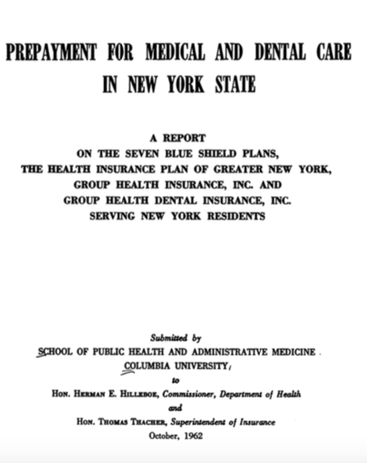
1924
1949
1962

Slide 10
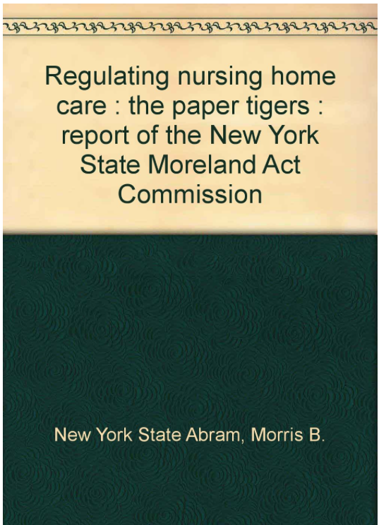
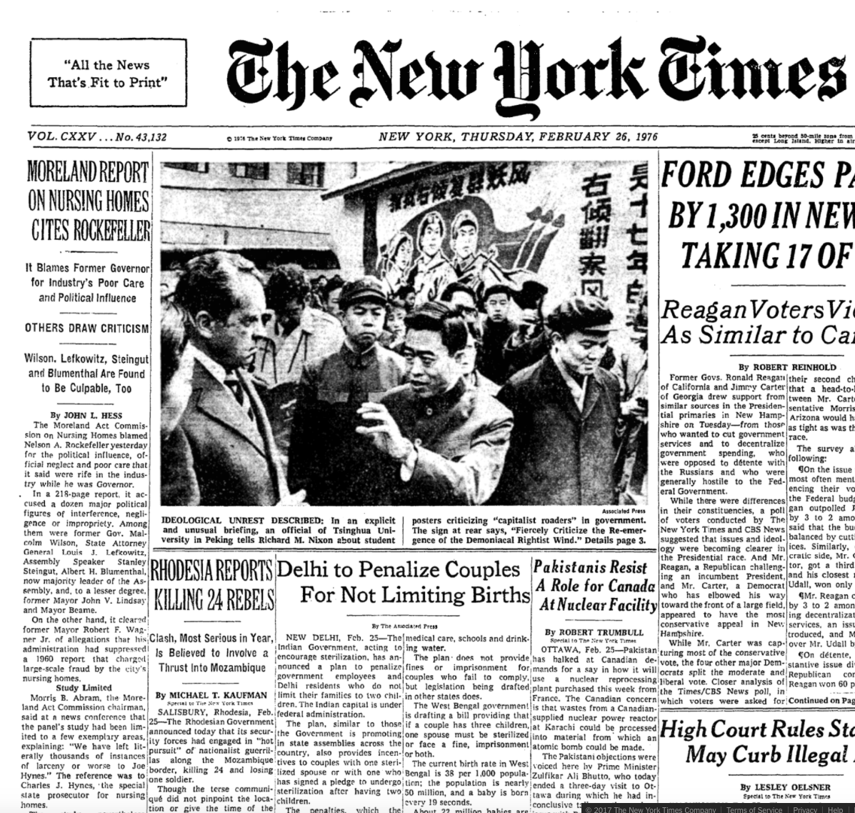

Slide 11
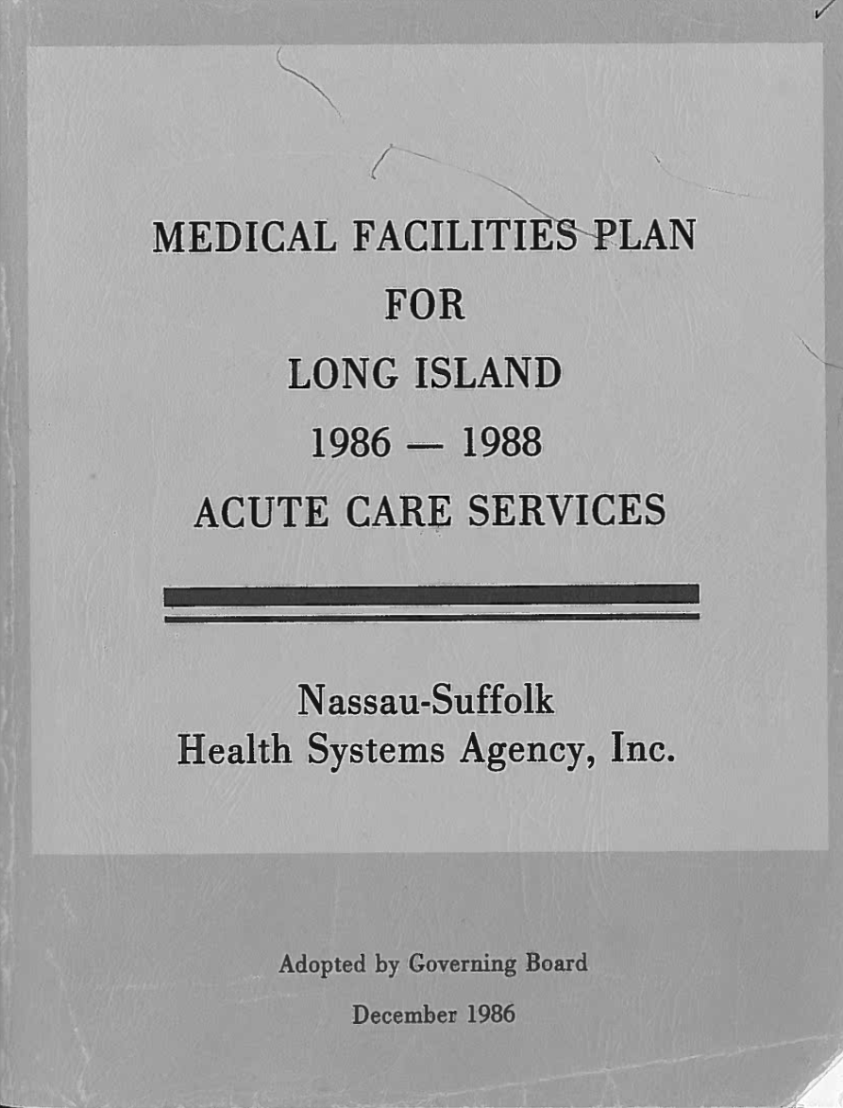
1986
1991

Slide 12
2006

Slide 13
2011
2013
2014

Slide 14
Health Across all Policies Initiative Launched to Support the
Prevention Agenda Goal of Becoming the Healthiest State
The Governor's announcement called on the Public Health and Health Planning Council and its Ad Hoc Committee to Lead the Prevention Agenda, to lead this effort.

Slide 15
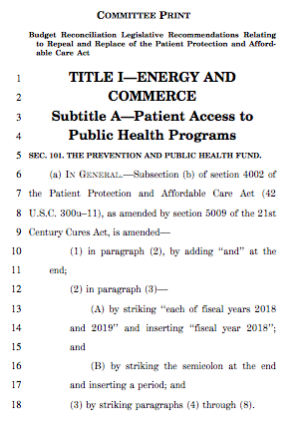

Slide 16
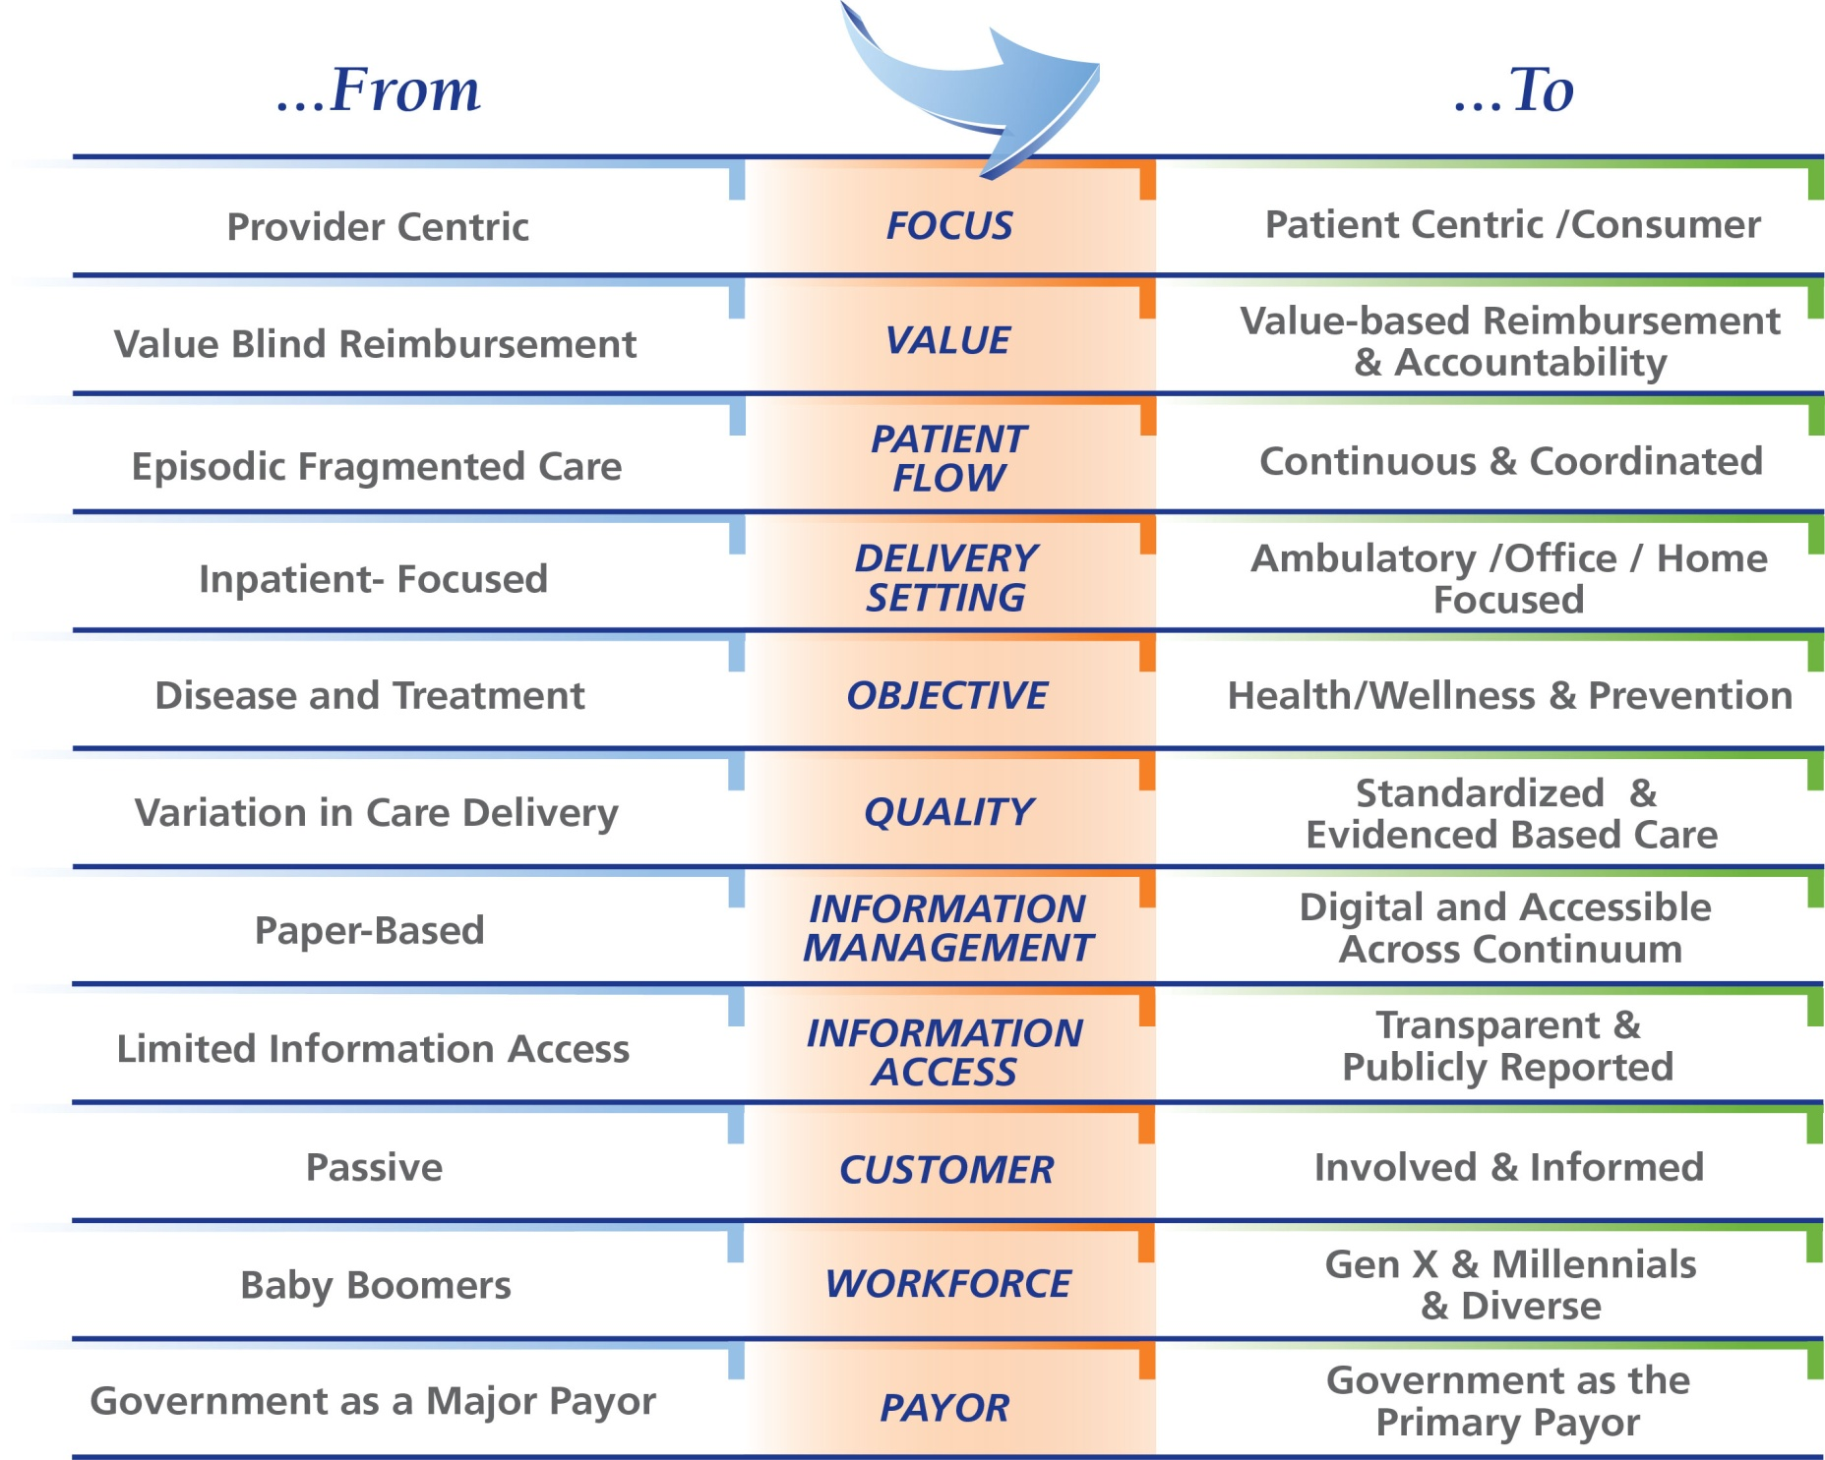
The Changing Landscape

Slide 17
Responding to the Forces of Change
nursing shortages
corporate compliance
medical cost inflation
bed shortages
access to capital
system disintegration
underinsured population
patient safety
workplace violence
JCAHO
robotics
HIPAA
declining reimbursement
telemedicine
recruitment/retention
shift to outpatient services
ethics
Board of Trustees
ACA IMPLEMENTATION
genomics
workplace hazards
chemical warfare
workers compensation
staff shortages
informed consumers
Leapfrog Group
union issues
bioterrorism
patient satisfaction surveys
staff education
BBA
patient diversity
medical education
health disparities
universal precautions
rising prescription costs
staff satisfaction
ACA
RENOVATION
hospital “report cards”
clinical trials
workforce diversity
medical errors
medical research
malpractice rate increases
physician relationships
technology
aging population
community health
sexual harassment
parking
mass casualties
risk management
operational efficiencies
OSHA
hospital mergers
internet
undocumented aliens
alternative medicine
Payment Reform
market competition
consumer confidence
uninsured patients
crowded emergency departments
physician “loyalty”
employee benefits
needed capital improvements
CMS
security
stock market devaluation
health department

Slide 18
Thinking Differently
Re-Defining The Regulatory Framework
Innovate

Slide 20
Department of Health
Public Health and Health Planning Council
“Council… shall, at the request of the commissioner of health, consider any matter relating to the preservation and improvement of health , and may advise the commissioner thereon; and it may from time to time submit to the commissioner any recommendations with it may deem wisely.”

Slide 25
Department of Health
Public Health and Health Planning Council
25
Notes:
25

