Slide 1


DSRIP Webinar - Governance
DSRIP Support Team
October 13, 2014

Slide 2
Agenda
Governance Considerations
PPS Governance Models
PPS Partners
Closing Thoughts

Slide 3
Purpose
The purpose of this webinar is to further explore the subject of PPS Governance and supplement the current Governance How-To Guide that is published on the New York State DSRIP web site. It is not the intent of this webinar to repeat or review the content of the How-To Guide.
  PPSs should not rely on this material alone when building their governance model. Appropriate legal guidance is essential.

Slide 4
Governance Evolution
Governance models will differ among PPSs and evolve over time.
It is expected that PPS governance will evolve over the five-year DSRIP Program. Some of the governance elements that may evolve include:
      The degree of integration
      Legal structure
      The number and types of partners
      The operating agreement
  DOH is not prescriptive on how each PPS needs to set up their governing structure.
      Each PPS has the flexibility to design what works best for them
      There is no one right answer
Notes:
There are a number of factors that will drive PPS evolution:
The health care environment will change
PPSs will develop new capabilities
The patient population will change
Partners and vendors may change

Slide 5
Governance Requirements
By April 1, 2015, PPSs are required to have essential elements of governance in place to enable them to initiate DSRIP projects.
In order to mitigate problems on April 1st, PPSs are encouraged to prioritize the development of the elements of governance along the DSRIP time line. Those that should be done first include:
      The ability to receive and distribute DSRIP funds
      The ability to make decisions
      Key positions are populated – the seats on the Executive Body and the Chairs of all Committees
  The governance elements that occupy the second tier include:
  The development of clinical pathways
  Decisions on the degree to which financially struggling partners are supported
  The finalization of the procedure to manage non-performing partners
Notes:
Within DSRIP, it will be key for the PPS to be able to make decisions about funds flow, the use of data for accountability, and to have agreements between the partner organizations within each PPS coalition. This implies that in some way or form, the partner organizations relinquish some of their own decision making authority to the PPS level – whether through contractual agreements or a new legal entity

Slide 6
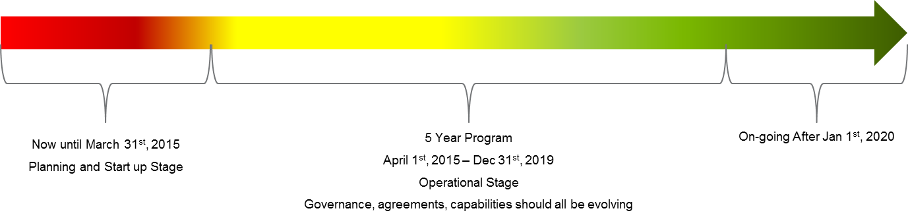
Governance Requirements
While the development governance can be prioritized, by April 1st the PPS should have in place:
Form the Financial, Clinical and IT/Data Governance Committees
Fill all Committee seats
Begin Committee work
Complete a Compliance Program
Establish a dispute resolution process
Document a process to manage non-performing partners and vendors

Slide 7
Finance Evolution
PPSs will also need to consider additional financial, clinical, and IT/Data capabilities.
Additional Financial Governance capabilities that will be needed include:
      Methods to manage cost/revenue shifting
      Degree to which financially struggling Partners will be supported
      Budget development
      Financial reporting

Slide 8
Clinical Evolution
PPSs will also need to consider additional financial, clinical, and IT/Data capabilities.
Additional Clinical Governance capabilities that will be needed include:
      Clinical leadership development
      Clinical pathway development
      Selecting and reporting appropriate clinical metrics
      Oversight of clinical pathway dissemination and training
      Engagement of direct-care providers

Slide 9
IT/Data Evolution
PPSs will also need to consider additional financial, clinical, and IT/Data capabilities.
Additional IT/ Data Governance capabilities that will be needed include:
      Data sharing agreements
      Standardizing data definitions
      Oversight for data security and compliance
      The development of standardized performance dashboards and reports

Slide 10
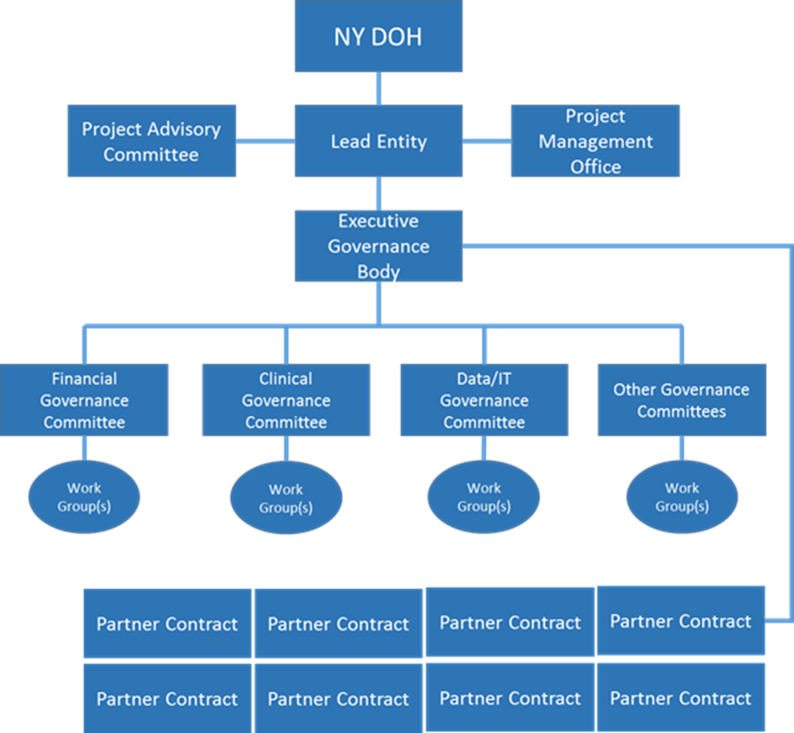
Governance Models – Collaborative Contracting
The DOH Governance “How-To” Guide presents three sample governance structures to illustrate the range of possible approaches.
Collaborative Contracting – the Lead Entity establishes contracts with all other partners to stipulate roles and responsibilities.

Slide 11
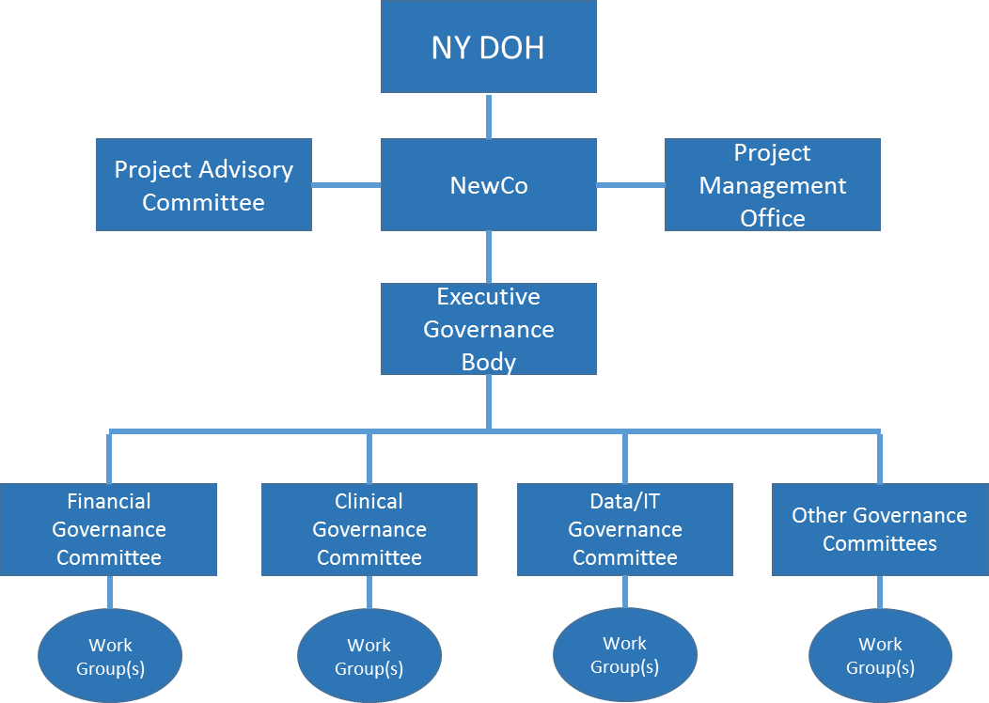
Governance Models – Delegated Authority
The DOH Governance “How-To” Guide presents three sample governance structures to illustrate the range of possible approaches.
Delegated Authority – a new legal structure, often an LLC, is formed and the partners delegate certain authority to the new organization.

Slide 12
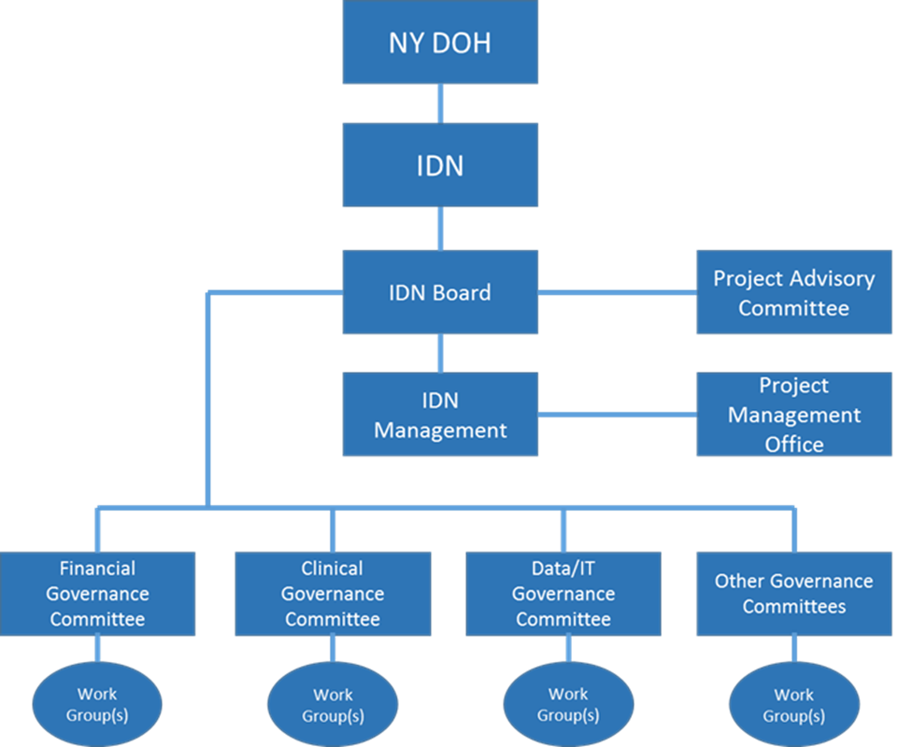
Governance Models – Fully Incorporated
The DOH Governance “How-To” Guide presents three sample governance structures to illustrate the range of possible approaches.
Fully Incorporated – the partners merge into a new, integrated delivery system and the work of the PPS becomes part of a single management and governance structure.

Slide 13
Governance Models – Comparison
The three sample Governance Models present varying strengths and weaknesses.
Model | Strengths | Weaknesses | Comments
Collaborative Contracting | Can be set up relatively quickly No new entities need to be created; partners retain their individual autonomy. | Number of contracts can be unwieldy Because decision making can be cumbersome, this governance structure often cannot deal well with unforeseen circumstances Potential for conflicts when limits of contract are reached Rigidity of structure Difficult to fully realize value based contracts with MCOs with this structure | This is a possible early governance model because initial buy-in of provider partners is relatively easy
Delegated Authority | Can be more efficient by centralizing decision making Can limit delegation of powers to the new entity to those aspects directly necessary for DSRIP | Potential to lose buy-in of partners Can be a challenge to agree on what is delegated | Will require an effort to maintain transparency
Fully Incorporated Mode | Most efficient decision making | Partners lose autonomy Partners may not want to join, making functional completeness difficult | May ultimately be the best model to tie in non-facility partners
Notes:
Collaborative Contracting is the easiest politically but can require considerable time to obtain all the needed contracts for the various types of participants.
Full Incorporation requires the most up-front negotiation, but ultimately produces the most efficient management structure

Slide 14
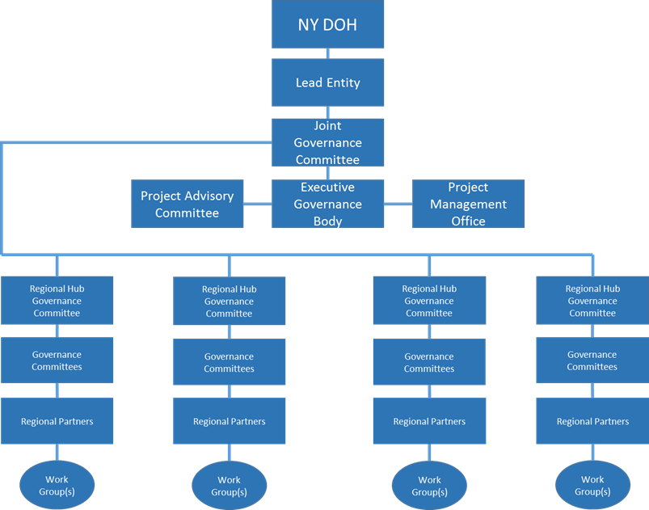
Governance Models – Regional Hub Option
A variation that can be applied to all Governance Models uses “Hubs” to augment the organizational structure.
The hubs can be geographic or functional or both
In a rural environment, using geographic hubs pushes decision making closer to the sites of care and strengthens local engagement
In an urban environment, using functional hubs such as acute care providers, nursing facility providers and the like helps to manage the large number of Partners and vendors

Slide 15
Governance Support
Regardless of the model selected, once the structure is decided each PPS will need to develop supporting documentation.
Supporting documentation includes:
    Operating Agreement
    Guidance for committee structure
    A process for collaboration
    A process for stakeholder engagement
    Decision rules
    Performance monitoring
    Liability
    Financial accountability and oversight

Slide 16
Partners
Like the variation in governance models, there will be variation in the types of partner involved with the PPS.
Capital Contributing Partner(s) of an LLC or IDS
A Lead Partner(s) who is responsible for fiduciary and project management control
Governance Partners who are members of the Boards and Committees
Participating Partners who are Partners by nature of the beneficiary attribution and act only in an advisory capacity
Affiliates who might be direct-care providers or community based organizations

Slide 17
Conclusions
PPS governance models are crucial elements of the DSRIP program that will evolve over time. PPSs need a strong start in April to put themselves on the right path.
The governance model the PPS creates will guide the work of the PPS
PPSs should expect to modify their governance structures over time
The DSRIP application is expected to be thoughtful and complete regarding the choice of governance structure
The governance goal for April 1, 2015 is to establish basic functionality

Slide 18
DSRIP Support Team

