Slide 1
Owning, Insuring, and Maintaining a Vehicle

Slide 2
Session Goals
Students will know their responsibilities for keeping their vehicle in proper working order and insured.

Slide 3
Key Vocabulary and Topics
Power Steering Fluid
Washer Fluid
Coolant
Radiator Cap
Brake Fluid
Oil Change
Air Filter
Hood Latch
Tire Pressure
Overinflated
Underinflated
Windshield Wipers
Battery
Battery Terminals
Leasing
Depreciation
Car Insurance
Policy
Premium
Deductible
Collision Insurance
Comprehensive Insurance
Monthly Driving Costs
Preventative Maintenance
Basic Auto Maintenance

Slide 4
What Goes Into Owning and Maintaining a Motor Vehicle?

Slide 5
Buying a Vehicle
Considerations When Purchasing a Vehicle:
Purchase price
Depreciation
Financing
New/Used/Leased
Vehicle size
Engine size and types
Transmission (manual/automatic)
Optional Equipment

Slide 6
Leasing Vehicle Considerations
Responsible for monthly payments and maintenance.
It is always a new vehicle.
You have a lease contract which expires.
At the end of the lease, you can return the vehicle and lease another, purchase the vehicle at a cost determined at the start of your lease, or return the vehicle with no obligation.
Leasing limits how many miles you can put on a vehicle. Extra miles cost an additional charge.
Insurance premiums may be higher, as the car will need to be “fully insured”.
There may be restrictions on the vehicle.

Slide 7
New vs. Used Vehicle
What factors should you consider when buying a new or used vehicle?
New versus used vehicle “calculator” resources available online

Slide 8
Owning and Maintaining a Vehicle Learning Activity
With a partner, research a vehicle you would like to buy
Next, use an auto loan calculator to determine your monthly payments at 4% interest (approximate)
Keep these calculations handy…

Slide 9
Purchasing a Used Vehicle
Consider how much you can afford
Research value of vehicle
Besides looking good, make sure the vehicle is in good working mechanical condition
Determine whether it was involved in a collision or needs repairs
If possible, talk to the previous owner about the condition and maintenance done on the vehicle
Research interest on car loans (compare banks)

Slide 10
What to Check
Check the doors and locks
Vehicle appearance
Fluid leaks
Evidence of collision damage
Sit in the vehicle and check seats for comfort and condition
Make sure lights and accessories work
Look at the mileage (odometer)
Can you reach the pedals and steering wheel?
Can you adequately see out the rear window over the seats?

Slide 11
What to Check
Check the trunk for evidence of rot/damage
Check to ensure if there is an inflated, good spare tire
Is there a tire jack?
Under the hood check for signs of collision damage, hoses and radiator leaks, cracks in hoses and belts, coolant level and battery/battery cables.
Take a test drive and listen for sounds, test the brakes, ensure firm steering, good suspension, note hesitations when accelerating
Have the vehicle inspected by a mechanic

Slide 12
Driving Costs - 2019
Vehicles vary widely in the cost to operate and maintain them. Search for a couple of different vehicles to find out the following for the latest model year.
Type of Car | Tax Incentive? | Average insurance premium | Maintenance | Repairs | Depreciation | Fuel Cost | True Cost to Own
Toyota Prius
Mini Cooper
Chevy Malibu
Ford F150

Slide 13
Vehicle Ownership
Certificate of Title
Shows proof of ownership and will include:
The owner’s name and address
The vehicle identification number (VIN)
The odometer reading upon purchase
Weight class
If the owner has purchased the vehicle on a time-payment plan (loan), the title also will indicate that there is a lien (debt owned) on the vehicle.
This document should not be stored in your vehicle!

Slide 14
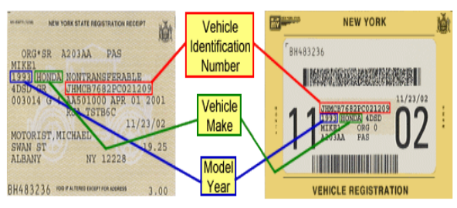
Registration
All vehicles, trailers, and boats must be registered in New York
Registration costs very based on the vehicle
New York State Department of Motor Vehicles. Sample Registration. https://dmv.ny.gov/registration/sample-registration-documents

Slide 15
New York State Inspection
New York requires all vehicles to be inspected yearly at a cost of $15.00 for most cars
New York State WILL NOT send you a reminder
The color of the sticker changes annually
Things that will cause you to fail inspection:
Cracked or discolored mirrors
Deteriorated windshield wipers
Check engine or service engine soon light is on
Failing brakes
Bad frame, suspension, steering, and wheel fasteners
Bald tires
Incorrect window tint
Some lights not working
Fuel leaks

Slide 16
What Determines Insurance Rates?
Driving record (Driver’s abstract)
Age
Miles driven
Driver gender
Marital status
Type of vehicle
Where the driver lives and drives
Driver’s claim record
Driver education programs taken
Years of driving experience
Credit history
Previous insurance coverage
Coverage and deductibles

Slide 17
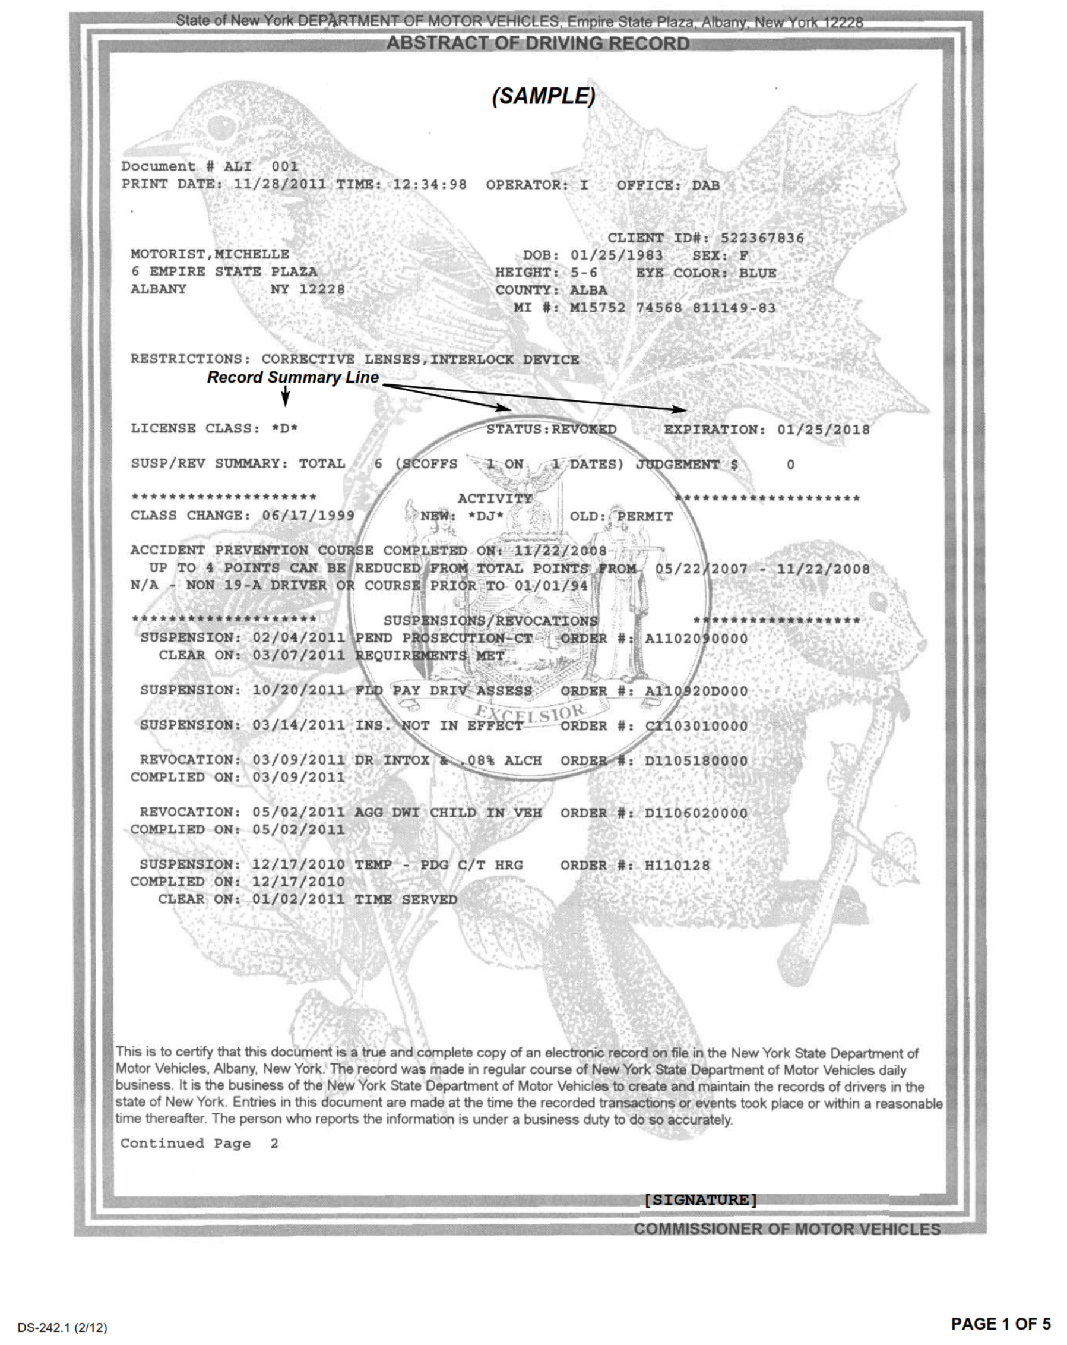
Sample of a Driver Abstract
New York State Department of Motor Vehicles. Sample Abstract of Driving Record. https://dmv.ny.gov/forms/ds2421.pdf

Slide 18
What Do the Coverages Mean?
Kind of Insurance | Coverage | Claim Includes | Minimum Amount | Notes
Personal Injury Protection (PIP) | Medical, loss of income, and other miscellaneous expenses | • Medical expenses • Loss of income: Max of $2000 a month or 80% of current monthly income • $25 per day for reasonable expenses • $2000 death benefit | $50,000/Most common is $50.000 | Required by law Also known as “No Fault Insurance”
Bodily Injury Liability | Pays claim against owner if someone is killed or injured and owner is at fault | Hospital and doctor bills, Legal fees; Court costs; Loss of wages | $25,000/$50,000 $25,000 per person and $50,000 per crash in bodily injury benefits | Required by law Most Common is $300,000
Property Damage Liability | Pays claim against owner if property of others is damaged and owner is at fault | Other car and possessions in vehicle. Damage to house, telephone pole and traffic light. | $10,000 | Required by law

Slide 19
What Do the Coverages Mean?
Kind of Insurance | Coverage | Claim Includes | Minimum Amount | Notes
Statutory Uninsured Motorist | Pays for injuries sustained by you and your passengers caused by an uninsured motorist | • You and passenger injuries | • $25,000 per person and $50,000 per accident for those accident for those that occur WITHIN NYS. • Serves as supplementary insurance if outside of NYS | Required by law
Optional Basic Economic Loss (OBEL) | This coverage provides an extra amount on top of the no-fault limit |  |  | Not Required Most common is $25,000
Supplementary Uninsured Motorist | Extends coverage to accidents that occur outside of New York State |  |  | Not Required $50,000 is most common

Slide 20
What Do the Coverages Mean?
Kind of Insurance | Coverage | Claim Includes | Minimum Amount | Notes
Medical Payments | Coverage that reimburses you and your passengers for medical or funeral expenses stemming from an accident, regardless of responsibilities |  |  | Not Required $5,000 is most common
Collision | Reimburses you for damage to your own car resulting from impact with another car or an object |  |  | Not Required Most common is $500 deductible
Comprehensive | Reimburses you for damage to your auto not caused by a collision |  |  | Not Required $200 deductible is most common

Slide 21
Owning and Maintaining a Vehicle Learning Activity
You and your partner decided to buy a used or new vehicle, research your vehicle’s mpg.
You calculated an auto loan at 4% (since you’re young and may have limited credit).
You kept your calculations handy…
Using your previous calculations, use an insurance company website to determine which type of coverage is best for you. Keep in mind that you’ll have to meet the NYS insurance minimum on the previous slide.
Finally, use an online insurance estimator to get quotes.
Create a table like the one on the next slide to share your results.

Slide 22
Owning and Maintaining a Vehicle: Results Example
Car | New/Used? | Purchase Price? | Monthly Auto Payment (Based on Purchase Price at 4%+) | Estimated Insurance? + | Gas per month (# of miles driven ÷ mpg* $3/gallon) = | Total Monthly Cost | 5 Year Cost to Own (from KBB)
2017 Audi A3 | New | $45,000 | $828.74 + | $150 + | 900/27 = 33.33 gallons * $3 = $100 | $1078.7 4 | $60,085

Slide 23
You’ve Bought and Insured a Vehicle….
NOW YOU HAVE TO MAINTAIN IT!
New vehicles come with warranties based on years and miles driven and specific to the vehicle you have chosen
Used vehicles may or may not have transferable warranties

Slide 24
Preventative Maintenance
What is preventative maintenance on a vehicle?
The care you routinely give your vehicle to avoid trouble later is preventative maintenance. This attention includes not only day-to-day care, but also the periodic servicing a vehicle needs at times listed in the owner’s manual.

Slide 25
Vehicle Maintenance
Driving costs are affected by how well your vehicle runs. Performing regular maintenance can ensure more efficient operation and help prevent costly repairs down the road.
Fluids: Engine oil, engine coolant, brake fluid, transmission fluid, and power steering fluid
Gasoline: Use gasoline with the octane rating as recommended by the vehicle manufacturer (check vehicle owner’s manual).

Slide 26
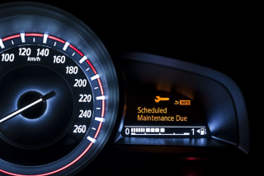
Vehicle Maintenance
Air filter: Captures dirt particles and ensures clean airflow to the engine. Inspect at every oil change. Located in the engine, as well as a cabin air filter.
Belts: Most vehicles use a single serpentine belt to operate under-hood accessories such as the alternator, although v-belts are used in some applications. Inspect at every oil change.
Hoses: Circulate vital liquids such as engine coolant, transmission fluid and power steering fluid. Inspect at every oil change.

Slide 27
Vehicle Maintenance
Battery: Powers the starter motor, acts as a voltage stabilizer for the electrical system and makes up any shortfall when the alternator cannot meet the vehicle’s electrical demands. Inspect the battery cable connections at every oil change and clean as needed. Always wear eye protection and gloves when servicing a battery.
Tires: As the only part of your vehicle in contact with the road, tires have a major effect on ride, handling, braking and safety. For the best performance, tires must have sufficient tread depth, no signs of physical damage, and be properly inflated. Inspect tires and check inflation pressures at least once a month.

Slide 28
Vehicle Maintenance
Driving for maximum fuel economy and minimal impact on the environment.
By developing fuel saving driving habits, you can increase your fuel economy and decrease the impact on the environment throughout your driving career.

Slide 29
Tips to Save Fuel
Avoid long idling
Use the fuel grade specified in your owner’s manual
Follow the preventative maintenance schedule in your owner’s manual
Eliminate unnecessary weight in the vehicle
Maintain appropriate tire pressure (PSI)
Use cruise control on highways
Use AC sparingly and park in the shade
Avoid aggressive driving
Fleet Fuel incentive cards from retailers may offer a reduced fuel price

Slide 30
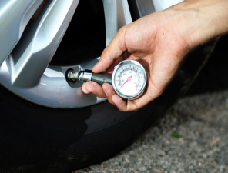
Tires
It is important to maintain and replace tires when tread becomes worn or if the tire wall becomes damaged.
Proper PSI will save fuel AND improve the life of the tire.
Tire pressure may change with changes in season and with wear, so check them often.
Visually inspecting tires can reveal excessive and/or uneven wear due to poor tire alignment.
Rotate tires every other oil change and ensure tires are aligned.

Slide 31
Prevention is Key
Always listen for new/different sounds your vehicle is making
Look it over by noticing tire wear, vehicle leaning, and things hanging down under the vehicle
What are other common items on the car that you will need to pay attention to?

Slide 32
Prevention is Key
Regular oil changes (4-6,000 miles)--check your owner's manual
Transmission check-up at prescribed intervals (owner’s manual)
Battery maintenance
Belts and hoses should be checked (pinch them and look for cracks)
Brake and tire inspection/tire rotation/balance and alignment
Regular windshield wiper replacement
Spark plug replacement at prescribed intervals (owner’s manual)
Filters replaced (engine air filter, cabin air filter, oil filter, fuel filter) as needed
Inspect shock absorbers at prescribed intervals per the owner’s manual or as needed

Slide 33
Basic Maintenance Learning Activity
Use the internet to briefly research basic maintenance activities and fill out the Basic Automotive Maintenance Worksheet. Be prepared to share what you learned with the class.

Slide 34
References
New York State Auto Coverage (NYCM). Automobile Insurance: Auto Coverage Guide.

